Slide 1
AERAC
University
Accreditation
Process
William Wiener 6/2/20

Slide 2
History of University Review
AER Divisions separately reviewed University Programs in the 1970’s
In the early 2000’s program reviews were erratic
AER Program review in 2009-2010 was consolidated under an interdivisional approach supported by AER Board rather than though the individual divisions
Review was made electronic
  Standards were revised
  New structure was developed
Notes:
History of University Review
AER Divisions separately reviewed University Programs in the 1970’s
In the early 2000’s program reviews were erratic
AER Program review in 2009-2010 was consolidated under an interdivisional approach supported by AER Board rather than though the individual divisions
Review was made electronic
Standards were revised
New structure was developed

Slide 3
Current Directions
Over past decade, many universities have undergone AER review
Accredited programs are listed on the AER Website
In 2016 the AER Board approved a plan to move from university approval to university accreditation
Notes:
Current Directions
Over past decade, many universities have undergone AER review
Accredited programs are listed on the AER Website and we will look at them towards the end of the PowerPoint
In 2016 the AER Board approved a plan to move from university approval to university accreditation

Slide 4
Evolving Directions
In 2017 the AER Board absorbed the previous National Accreditation Council activities
  Twelve-person accreditation board was developed
  Accreditation board has restructured and has incorporated university accreditation
Eventual recognition by CHEA
Notes:
Evolving Directions
In 2017 the AER Board absorbed the previous National Accreditation Council activities
Ten person affiliate board was developed
In 2018 Affiliate board is in the process of approving all standards and is incorporating university standards
Eventual Recognition by CHEA – Council of Higher Education Accreditation – OT, PT, Social Work, etc.

Slide 5
Accreditation Structure
AER Board
AER Accreditation Council
Executive Committee
School Accreditation
Higher Education
Accreditation
Executive
Committee
Organization Accreditation
Membership
School
Review Panel
Agency
Review Panel
Review
Panel
Notes:
Accreditation Structure
New Structure for Accreditation: now encompasses specialized schools, agencies (as the old NAC did) but now also includes university reviews
There are two separate structures: the AER Board and membership structure; AND an independent AER Accreditation Council
Important for the AER Accreditation Council to make independent decisions from the AER board to give it the authority it needs and the legitimacy that is required

Slide 6

Overview of University Review
AER Accreditation Council
-- Approves Accreditation Status Recommendation
-- Adjudicates Appeals
-- Follows up on Conditional Accreditation
Higher Education Accreditation Commission
-- Develops Standards
-- Appoints Review Panel
-- Reviews and Approves Recommendation
AER
Central
Office
-- Coordination
Review Panel
-- Evaluates Program
-- Formulates Recommendation
Notes:
Overview of University Review
Depend upon AER Central Office for coordination
Starts with Higher Education Accreditation Commission (HEAC) – develops standards and appoints review panels,
Next the review panel uses the standards to evaluate the university programs and report back to HEAC to review the recommendation
Finally the AER Accreditation Council approves the recommendation for accreditation, It also adjudicates appeals and follows up on conditional accreditation – which we will talk about soon

Slide 7
AER Accreditation Council
  Policy and Standards Approval
  Accreditation Decisions
  12 Members
    Recommended by members and approved by Executive Director
    Chair – AER Executive Director
    Representatives of Consumer Organizations
    Representative of Divisions
    Representative of Universities
    Representative of Adult Organizations
    Representative of Schools
    Members at Large
Notes:
AER Accreditation Council
Policy and Standards Approval
Accreditation Decisions
12 Members
Recommended by members and approved by Executive Director
Chair – AER Executive Director
Three representatives of Consumer Organizations
Three representatives of experts in the field
Chair of the Higher Education Accreditation Commission
One representative of Adult Organizations
One representative of Schools
One public member

Slide 8
Higher Education Accreditation Commission
(HEAC)
  Policy and Standards Development
  Selection of Review Panels
  Reviews Panel Recommendations
  Members
    Chair – Member of the AER Accreditation Council
    Representative from Low Vision Rehabilitation Division
    Representative from Orientation and Mobility Division
    Representative from Vision Rehabilitation Therapy Division
    Representative from Personnel Preparation Division
    Representative from Information and Technology Division
    Member at Large
Notes:
Higher Education Accreditation Commission (HEAC)
Policy and Standards Development
Selection of Review Panels
Reviews Panel Recommendations
Members
Chair – Member of the AER Accreditation Council
Representative from Low Vision Rehabilitation
Representative from Orientation and Mobility
Representative from Vision Rehabilitation Therapy
Representative from Personnel Preparation
Representative from Assistive Technology
Public member

Slide 9
University Review Panel
The University Review Panel (URP)
  Members who have completed webinar and passed quiz
  Members work in teams of 4 to review
    Team has one university member, two members of the discipline, and one from a related discipline
    All 4 review core standards
    Pairs divide the disciplinary standards and use Survey Monkey rubric
    Team chair conducts phone interviews with: 1) faculty 2) students
    Team makes recommendation
Notes:
The Accreditation Review Panel (ARP)
Members who have completed this webinar and passed a quiz
Members work in teams of 4 to review
Team has one university member, two members of the discipline, and one from a related discipline
All 4 review core standards
Pairs divide the disciplinary standards and use Survey Monkey rubric
Team chair conducts phone interviews with: 1) faculty 2) students
Team makes recommendation
Each review requires a team of four reviewers (who each receive a stipend for their work). The team selects a chairperson who coordinates the activities and conducts conference calls with the administrators, faculty, and students of the program. The team members each review all of the Core requirements. The team divides the curricular guidelines and distributes them among pairs of reviewers. If there is disagreement regarding the ranking of a particular standard, a member from the alternative team will also review the standard.

Slide 10
Steps in University Review Process
The program submits letter of intent to apply for review (30 days in advance)
The program completes a self study guide and submits on-line using approved naming format (template available).
A review team is appointed by AER and confirmed by the University
A Kick-Off conference call is held to divide up the panel tasks
The review team studies the self study guide submitted online and completes rubrics online using Survey Monkey to determine compliance
The review team chair or his/her designee conducts separate telephone interviews with program leadership and students
  This could result in changes to previous submissions on Survey Monkey
The review team chair convenes a telephone conference for its members to discuss the complied data, formulate a report, make a recommendation and submit findings and preliminary recommendation to the Higher Education Accreditation Commission (HEAC)
The HEAC determines if standards are met and status recommendation
Chair of HEAC presents recommendation to the AER Accreditation Council for a vote
Note: Review team should follow detailed instructions provided in the document labeled “MODEL TEAM REVIEW PROCESS”
Notes:
Steps in University Review Process
The program submits letter of intent to apply for review (30 days in advance)
The program completes a self study guide and submits on-line using approved naming format (template available)
A review team is appointed by AER and confirmed by the University
A Kick-Off conference call is held to divide up the panel tasks
The review team studies the self study guide submitted online and completes rubrics online using Survey Monkey to determine compliance
The review team chair or his/her designee conducts separate telephone interviews with program leadership and students
This could result in changes to previous submissions on Survey Monkey
The review team chair convenes a telephone conference for its members to discuss the complied data, formulate a report, make a recommendation and submit findings and preliminary recommendation to the Higher Education Accreditation Commission (HEAC)
The HEAC determines if standards are met and status recommendation
Chair of HEAC presents recommendation to the AER Accreditation Council for a vote

Slide 11
Processing Fee
$1750 is required fee to cover costs of the accreditation process.
  Second Program $1500
  Third Program $1250
The teams of reviewers receive a payment as a token of appreciation.
Notes:
Processing Fee
A $1750 is required fee to cover administrative costs of the accreditation process including recruitment and training of new panel reviewers, selection of reviewers, telephone conference calls, use of online survey instruments, and report preparation. Reductions to 1500 and 1250 for second and third programs.
The teams of reviewers receive $50 each as a token of appreciation.

Slide 12
Application Narrative
Three Sections
  Section I
    Background Information
  Section II
    Program Information
    List of Required Documents
  Section III
    Philosophy
    Strategic Direction
Notes:
Application Narrative
Three Sections
Section I
Background Information
Section II
Program Information
List of Required Documents
Section III
Philosophy
Strategic Direction
Purpose is to provide background
Applications will be accepted at any time throughout the year. We recommend that the program submit a letter of intent to apply 30 days prior to submission to allow for planning and preparation of a review team. Whenever possible, reviews will be completed and the program will be notified of the accreditation/disapproval status within 90 days.

Slide 13
Application Section II
LIST OF REQUIRED DOCUMENTS TO BE SUBMITTED
  Curricular vitae/resume for all program faculty and clinical supervisors
  Course Syllabi
  Current and proposed budgets
  Inventory of program materials for student use
  Proof of program evaluation
Notes:
Application Section II
LIST OF REQUIRED DOCUMENTS TO BE SUBMITTED
Curricular vitae/resume for all program faculty and clinical supervisors
Course Syllabi
Current and proposed budgets
Inventory of program materials for student use
Proof of Program evaluation – new section with specific requirements

Slide 14
Classification of Standards
Standards are classified as either CORE (all must be met) or CURRICULAR (at least 95% compliance) for full accreditation
Curricular (content applicable to a specific discipline) such as O&M, VRT, TSVI, LV, AT
Notes:
Classification of Standards
Standards are classified as either CORE (all must be met) or CURRICULAR (at least 95% compliance) for full accreditation
Curricular (content applicable to a specific discipline) such as O&M, VRT, TSVI, LV, AT

Slide 15
AER Personnel Prep Standards
Core Standards:
  Administrative Standards – 13
  Academic Faculty Standards – 4
  Clinical (Field Based) Faculty Standards – 4
  Clinical Standards – 9
  Assessment and Program Evaluation – 9
Curricular Standards
  OMS Standards – 169 (critical)
  VRT Standards – 168 (critical)
  TVI Standards – 240 (critical)
  LVT Standards – 74 (critical)
  AT Standards – 63 (critical)
All standards available at https://aerbvi.org/resources/career-center/university-review-program/
Notes:
AER Personnel Prep Standards
Core Standards:
Administrative Standards – 13
Academic Faculty Standards – 4
Clinical (Field Based) Faculty Standards – 4
Clinical Standards – 9
Assessment and Program Evaluation - 9
Curricular Standards
OMS Standards – 169 (critical)
VRT Standards – 168 (critical)
TVI Standards – 240 (critical)
LVT Standards – 74 (critical)
AT Standards – 63 (critical)
Standards are classified as either core or curricular. All must be met to receive full accreditation
Curricular standards are divided into O&M, TVI, and VRT standards, LVT, AT. At least 95% of the applicable curricular standards must be fully met with the remaining standards partially met to receive full accreditation.

Slide 16
Core Administrative Standards
Accredited by a regional higher education accrediting body
Internally recognized as part of a degree program or university recognized certificate program
Encompasses the competencies established for each discipline
In existence for a year
Offered at the baccalaureate or higher level.
University commitment is evident
ADA compliant
Maintains services to students with disabilities
Non-discrimination doctrine
Notes:
Core Administrative Standards
Accredited by a regional higher education accrediting body
Internally recognized as part of a degree program or university recognized certificate program
Encompasses the competencies established for each discipline
In existence for a year
Offered at the baccalaureate or higher level.
University commitment is evident
ADA compliant
Maintains services to students with disabilities
Non-discrimination doctrine

Slide 17
Core Administrative Standards
Adequate Physical Facilities
Necessary Equipment, Materials, and Assistive Technology
Adequate Library Holdings
Accessible and Usable Teaching Methods
Notes:
Core Administrative Standards
Adequate Physical Facilities
Necessary Equipment, Materials, and Assistive Technology
Adequate Library Holdings
Accessible and Usable Teaching Methods

Slide 18
Core Academic Faculty Standards
At least one full time faculty member with the responsibility of administering the program including supervision and/or direct provision of instruction
A minimum of 1 full time faculty member within the discipline being offered who dedicates at least .75 FTE to preparation of professionals (can be same as person above) (doctorate and 3 years experience)
A program with more than one vision discipline, must have at least one faculty with at least .50 FTE assignment in the additional vision discipline (O&M, VRT, TVI, LVT, ATIS) who must
  Have completed a university-based degree or certificate program in their specified profession (not necessarily doctorate) AND
  Must be ACVREP certified or in the case of TVI hold state teacher certification
Any adjunct faculty must have masters level preparation in their professional area, ACVREP or state teacher certification as appropriate, and at least 3 years full time field-based experience
Notes:
Academic Faculty Standards
At least one full time faculty member with the responsibility of administering the program including supervision and/or direct provision of instruction
A minimum of 1 full time faculty member within the discipline being offered who dedicates at least .75 FTE to preparation of professionals (can be same as person above) (doctorate and 3 years experience)
A program with more than one vision discipline, must have at least one faculty with at least .50 FTE assignment in the additional vision discipline (O&M, VRT, TVI, LVT, ATIS) who must
Have completed a university-based degree or certificate program in their specified profession (not necessarily doctorate) AND
Must be ACVREP certified or in the case of TVI hold state teacher certification
Any adjunct faculty must have masters level preparation in their professional area, ACVREP or state teacher certification as appropriate, and at least 3 years full time field-based experience

Slide 19
CORE Simulation Course Standards
Simulation courses (i.e., courses that include occlusion or low vision simulators as a major component of the course)
  For O&M: 1 faculty to no greater than 6 students per course section
    Includes all active travel experiences
  For Remaining Disciplines: 1 faculty to no greater than 15 students per course
    Includes class activities that require use of simulators during instruction
Notes:
Core Simulation Course Standards
Simulation courses (i.e., courses that include occlusion or low vision simulators as a major component of the course)
For O&M: 1 faculty to no greater than 6 students per course section
Includes all active travel experiences
For Remaining Disciplines: 1 faculty to no greater than 15 students per course
Includes class activities that require use of simulators during instruction

Slide 20
CORE Field Based Faculty Standards
Clinical supervisors (at university) must have at least 2 years direct service experience in specialization, a masters degree in any related area, and must hold ACVREP certification or for TVI personnel must have proper state teacher certification
Cooperating teacher/onsite supervisor (at school or agency) must have at least 2 years of direct service experience in the specialization, have completed a university-based program in the area they are supervising, and must hold ACVREP certification or for TVI personnel must have proper state teacher certification
Ratio in Clinical courses (i.e., courses such as practicum, fieldwork, and internship in which the candidate is providing observation, instruction and/or assessment to consumers through a placement at a school, agency, or clinic under the supervision of a faculty or adjunct faculty member):
  1 supervisor providing supervision to no greater than 8 students per class section
Notes:
Core Field Based Faculty Standards
Clinical supervisors (at university) must have at least 2 years direct service experience in specialization, a masters degree in any related area, and must hold ACVREP certification or for TVI personnel must have proper state teacher certification
Cooperating teacher/onsite supervisor (at school or agency) must have at least 2 years of direct service experience in the specialization, have completed a university-based program in the area they are supervising, and must hold ACVREP certification or for TVI personnel must have proper state teacher certification
Ratio in Clinical courses (i.e., courses such as practicum, fieldwork, and internship in which the candidate is providing observation, instruction and/or assessment to consumers through a placement at a school, agency, or clinic under the supervision of a faculty or adjunct faculty member):
1 supervisor providing supervision to no greater than 8 students per class section

Slide 21
CORE Clinical Field Standards
A minimum of 350 hours of clinical experience
A minimum of 250 direct instructional hours
Breakdown of the 350 is in accordance with certification guidelines for each discipline
University must observe the candidate on site or through video and audio recordings and provide written feedback for at least four lessons
University must have weekly contact with each candidate (student) to address any problems and discuss successes:
  face-to-face meetings/classes, individual phone calls, teleconferences, accessible/usable chat rooms, or email
If candidates are not in a full-time clinical placement, university contact must occur for every 20 hours of clinical experience rather than weekly
Have weekly contact with each cooperating teacher/onsite supervisor to discuss each candidate
To provide adequate field supervision, the cooperating teacher/onsite supervisor must observe and provide feedback for at least 1 out of every 5 hours of consumer contact at the beginning of the placement, decreasing as candidate skills and judgment improve
Notes:
Core Clinical Field Standards
A minimum of 350 hours of clinical experience
A minimum of 250 direct instructional hours
Breakdown of the 350 is in accordance with certification guidelines for each discipline
University must observe the candidate on site or through video and audio recordings and provide written feedback for at least four lessons
University must have weekly contact with each candidate (student) to address any problems and discuss successes:
face-to-face meetings/classes, individual phone calls, teleconferences, accessible/usable chat rooms, or email
If candidates are not in a full-time clinical placement, university contact must occur for every 20 hours of clinical experience rather than weekly
Have weekly contact with each cooperating teacher/onsite supervisor to discuss each candidate
To provide adequate field supervision, the cooperating teacher/onsite supervisor must observe and provide feedback for at least 1 out of every 5 hours of consumer contact at the beginning of the placement, decreasing as candidate skills and judgment improve

Slide 22
CORE Assessment/Program Evaluation Standards
Course syllabi must list major student learning outcomes for courses
Courses must indicate specific measures to determine outcomes
Must be a specific assessment plan in place
Must be evidence that outcomes have been determined and discussed
Must be evidence that assessment results were used to make changes
Must Be annual reporting to AERAC any changes to program including statistics on completion, graduation, and data on effectiveness
Must provide copies of clinical placement assessments
Programs must make statistics about the program available to the public
Programs must provide public information about effectiveness
Notes:
Course syllabi must list major student learning outcomes for courses
Courses must indicate specific measures to determine outcomes
Must be a specific assessment plan in place
Must be evidence that outcomes have been determined and discussed
Must be evidence that assessment results were used to make changes
Must Be annual reporting to AERAC any changes to program including statistics on completion, graduation, and data on effectiveness
Must provide copies of clinical placement assessments
Programs must make statistics about the program available to the public
Programs must provide public information about effectiveness

Slide 23
Curricular Standards
Divided into O&M, TVI, and VRT, LVT, AT standards.
At least 95% of the applicable curricular standards must be fully met with the remaining standards partially met to receive full accreditation.
Notes:
Curricular Standards
Divided into O&M, TVI, and VRT, LVT, AT standards.
All considered critical
At least 95% of the applicable curricular standards must be fully met with the remaining standards partially met to receive full accreditation.

Slide 24
Use of Rubrics
A rubric is a guide to scoring that provides a description, the evaluation criteria to be used, levels of the task required for success, and a scale for evaluation.
Rubrics make scoring more consistent and allow comparisons between evaluators and across different universities.
We use rubrics to score compliance
Notes:
Use of Rubrics
A rubric is a guide to scoring that provides a description, the evaluation criteria to be used, levels of the task required for success, and a scale for evaluation.
Rubrics make scoring more consistent and allow comparisons between evaluators and across different universities.
We use rubrics to score compliance

Slide 25
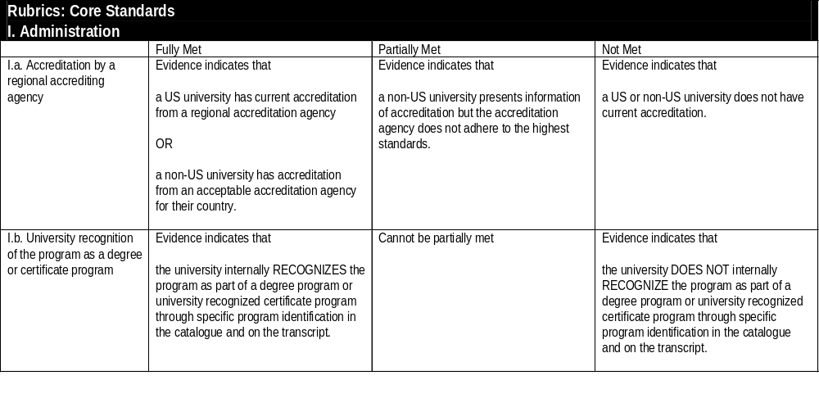
Example Core Rubric
Notes:
Example Core Rubric

Slide 26
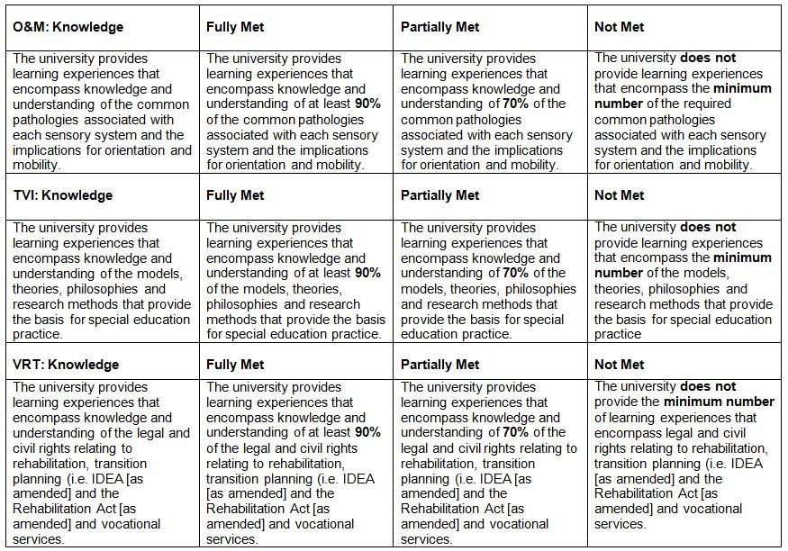
Example Curricular Rubric Metrics
Notes:
Example Curricular Rubric Metrics

Slide 27
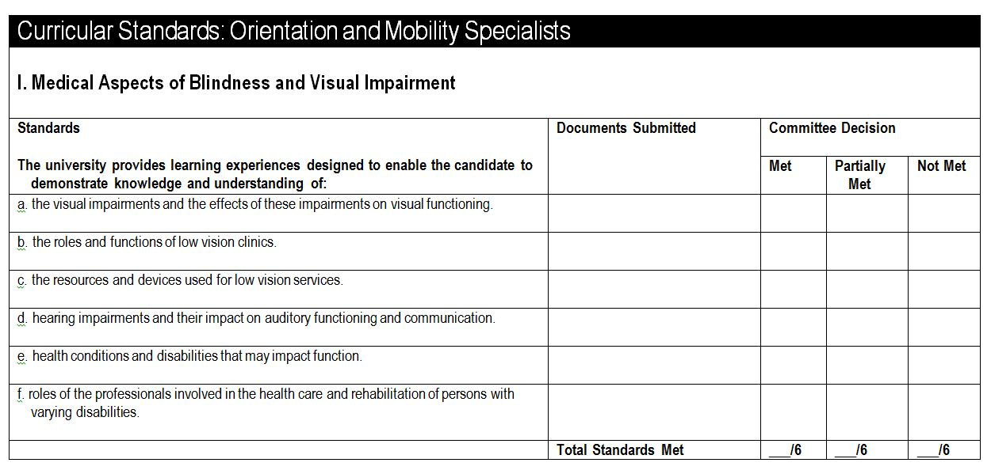
Example of Form for Curricular Standards
Notes:
Example of Form for Curriclular Standards

Slide 28
Accreditation Status
Full Accreditation: the university program has met the minimum standards in all of the criterion areas designated as absolute, and has met at least 95% of the criterion areas designated as critical.
Conditional Accreditation: the university program did not meet minimum standards in one of the absolute criterion areas and/or met between 85% and 94% of the criterion areas designated as critical, and the program agrees to rectify this shortcoming(s) within the short term. Conditionally approved programs that have demonstrated that they meet the conditions stipulated by AER within one year from the date of review will be granted full accreditation status. Students who enter an AER program with a status of conditional accreditation, and who successfully complete the degree, are considered to have completed an AER approved program.
Not Accredited: the university program did not meet minimum standards in a large number of criterion areas and this situation cannot be remedied in the short term.
Notes:
Accreditation Status
Full Accreditation: the university program has met the minimum standards in all of the criterion areas designated as absolute, and has met at least 95% of the criterion areas designated as critical.
Conditional Accreditation: the university program did not meet minimum standards in one of the absolute criterion areas and/or met between 85% and 94% of the criterion areas designated as critical, and the program agrees to rectify this shortcoming(s) within the short term. Conditionally approved programs that have demonstrated that they meet the conditions stipulated by AER within one year from the date of review will be granted full accreditation status. Students who enter an AER program with a status of conditional accreditation, and who successfully complete the degree, are considered to have completed an AER approved program.
Not Accredited: the university program did not meet minimum standards in a large number of criterion areas and this situation cannot be remedied in the short term.

Slide 29
Appeals
In situations where the university disputes the decision of the AER Accreditation Council, an appeal can be filed with the AER Central Office.
The AERAC will hear the case and then make a final determination by appointing an independent committee to review all materials.
Notes:
Appeals
In situations where the university disputes the decision of the AER Accreditation Council, an appeal can be filed with the AERAC through Central Office.
The AERAC will hear the case and then make a final determination by appointing an independent committee to review all materials.
Programs may appeal the decision to deny program accreditation. All appeals must be addressed to the AERAC and sent to the AER Central office by certified mail within 30 days of notification of the board’s decision.

Slide 30
Annual Follow-up
Accredited programs must annually complete and submit the University Preparation Program Update, a short yearly checklist.
Programs that are fully approved will maintain their accreditation status for five years assuming no major changes in the program are noted in annual follow-ups.
If violations of standards are found, the program has 60 days to rectify identified violations and file a revised report. Failure to do so may result in withdrawal of program accreditation.
Conditional status lasts only one year.
If a program ceases to exist for more than 12 months, the program must submit for review
Notes:
Annual Follow-up
Accredited programs must annually complete and submit the University Preparation Program Update, a short yearly checklist.
Programs that are fully approved will maintain their accreditation status for five years assuming no major changes in the program are noted in annual follow-ups.
If violations of standards are found, the program has 60 days to rectify identified violations and file a revised report. Failure to do so may result in withdrawal of program accreditation.
Conditional status lasts only one year.
If a program ceases to exist for more than 12 months, the program must submit for review

Slide 31
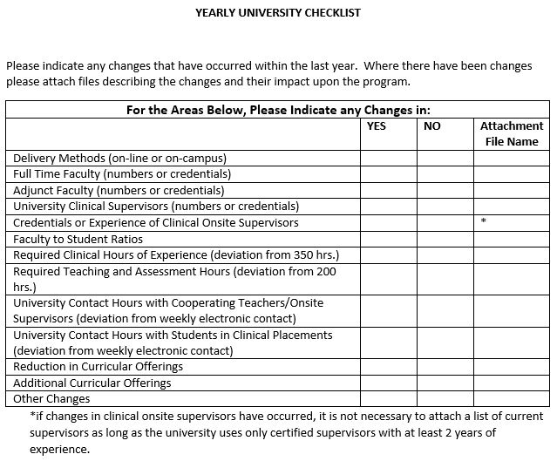
Program Update
Notes:
Program Update – see slide

Slide 32
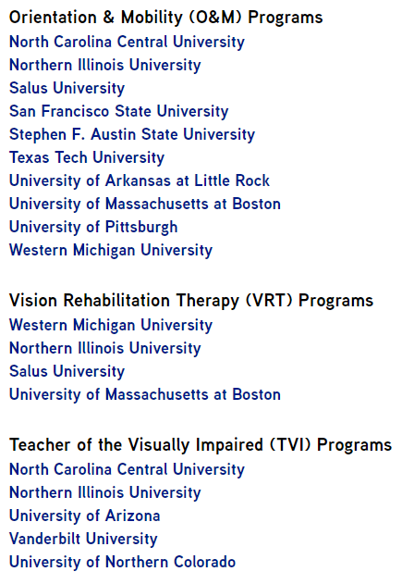
Currently Accredited Programs
Notes:
Currently Accredited Programs

Slide 33
Next Steps in Preparing for Reviews
Review Accreditation Handbook
Review this PowerPoint (to be sent out)
Read Instructional Modules One, Two, and Three (to be sent out)
Read Panel Review Process Document (to be sent out)
Take Exam (to be sent out)
Notes:
Next Steps in Preparing for Reviews
Review Accreditation Handbook
Review this PowerPoint (to be sent out)
Read Module One (to be sent out)
Read Panel Review Process Document (to be sent out)
Take Exam (to be sent out)

Slide 34

Discussion
Are you ready for a quiz?
Notes:
Questions

