Slide 1
Identifying and supporting economic needs of families, including children with cerebral visual impairment
Professor John Ravenscroft
John.Ravenscroft@ed.ac.uk
Andrew Blaikie
James Thom and Michael Cairns.
AER International Conference : RENO 2018: Evolve. Empower. Succeed.

Slide 2
A quick note of thanks to….
NHS National Services Scotland
The Scottish Government
VINCYP
Dr Andrew Blaikie
Prof Jugnoo Rahi

Slide 3
Brief Aim
Childhood Visual Impairment and its relationship with social deprivation
Particularly the relationship with CVI and social Deprivation
The need to collect and understand data

Slide 4
The Issue: Deprivation
Data from the Millennium Cohort Study (N=19,000 children born 2000-2001) & Data from the Longitudinal Study of Young People (N=16,000 – aged 13-14) in England shows¹:-
Childhood disability is associated with family socio-economic disadvantage. (Lone family and workless family) Children defined as disabled are more likely to come from disadvantaged families
This is the case in both younger childhood and in adolescence, and with any measure of disability used.
The association is greatest for those identified as having Special Educational Needs (SEN).

Slide 5
Millennium Cohort Study:
Visual Impairment
Children from the sample aged 3 years
Parental Reports analysed
Data collected using National Statistics Socioeconomic Classification
Child factors were collected
Cumberland, P. M., Pathai, S., & Rahi, J. S. (2010). Prevalence of eye disease in early childhood and associated factors: findings from the m
millennium cohort study. Ophthalmology, 117(11), 2184-2190.

Slide 6
“Having an eye disorder was associated with lower household socioeconomic status, decreasing birth weight, and prematurity” (p2188)
“Lower socioeconomic status was associated with eye disease, by severity.” (p2188)

Slide 7
Again we see
Rahi, J. S., Cumberland, P. M., Peckham, C. S., & British Childhood Visual Impairment Interest Group. (2010). Improving detection of blindness in childhood: the British Childhood Vision Impairment study. Pediatrics, peds-2010
40% (166 of 411) of children were in the worst national quintile of deprivation score (Carstairs Index)

Slide 8
What about Education Data and children with VI?
Year 9 Pupils and Deprivation Score
Factor | Group | No recorded SEN (n=491,096) | Other SEN (n=53,866) | Visually Impaired (n=873) | All Pupils (n=545,835)
IDACI Less Deprived Area | Quintile 1 ^{(*)} | 21.0% | 11.6% | 15.3% | 20.0%
 | Quintile 2 | 20.6% | 14.8% | 16.9% | 20.0%
 | Quintile 3 | 20.1% | 19.1% | 19.9% | 20.0%
 | Quintile 4 | 19.4% | 24.8% | 23.4% | 20.0%
Most Deprived Area | Quintile 5 ^{(**)} | 18.95 | 29.7% | 24.4% | 20.0%
ENGLAND:
Bassett, P. (2010) looking at attainment and progress at Primary School using School Census and National Pupil Database

Slide 9
English School data research suggests
Social deprivation is one of the factors that made it less likely that a pupil would do well educationally.
Primary aged pupils with a visual impairment are more likely than pupils with no recorded SEN to experience social disadvantage.(Free School meals + to live in a less economically well off area (IDACI score)
Living in more socially deprived area than the no recorded SEN group, but less socially deprived area than the other SEN group.
The VI group had the lowest proportion of pupils with English as a first language for all year groups.

Slide 10
IN SCOTLAND: Percentage of school leavers with 1 or more award at
SCQF 5 or above (16 year old Exams)
 | Most deprived 20% (SIMD20) | Least deprived 20% (SIMD80 to 100) | Gap (percentage points)
2011/12 | 65.8% | 93.9% | 28.1
2012/13 | 68.9% | 94.2% | 25.3
2013/14 | 71.9% | 94.6% | 22.7
2014/15 | 74.0% | 94.9% | 20.9
2015/16 | 74.4% | 94.7% | 20.3
SCQF 6 or above (17/18 year old Exams - )
 | Most deprived 20% (SIMD20) | Least deprived 20% (SIMD80 to 100) | Gap (percentage points)
2011/12 | 33.6% | 77.9% | 44.3
2012/13 | 34.9% | 77.3% | 42.4
2013/14 | 38.5% | 79.1% | 40.6
2014/15 | 41.2% | 80.3% | 39.1
2015/16 | 42.7% | 81.2% | 38.5

Slide 11
Scottish Government 2016 School Leavers with VI N = 315
SIMD¹ | 1+ passes at SCQF Level 2 or better | 1+ passes at SCQF Level 3 or better | 1+ passes at SCQF Level 4 or better | 1+ passes at SCQF Level 5 or better | 1+ passes at SCQF Level 6 or better | 1+ passes at SCQF Level 7
0-20% (Most Deprived) | 80.2 | 77.1 | 67.7 | 47.9 | 22.9 | 5.2
20-40% | 85.7 | 81.0 | 76.2 | 57.1 | 34.5 | 7.1
40-60% | 80.3 | 78.7 | 75.4 | 67.2 | 44.3 | 14.8
60-80% | 84.4 | 81.3 | 70.3 | 60.9 | 40.6 | 12.5
80-100% (Least Deprived) | 80.6 | 79.2 | 79.2 | 63.9 | 47.2 | 13.9
All leavers with visual impairment | 82.2 | 79.3 | 73.5 | 58.4 | 36.6 | 10.1
VI % GAP | 0.4 | 2.1 | 11.5 | 16 | 24.3 | 8.7
ALL Pupils % GAP | - | - | 6.1 | 20.3 | 38.5 | -

Slide 12
Problem with Scottish Gov Data
Scot Gov suggests
Mis match with medical data
Not seen via VI Teacher Service
 |  |  |  | Rate per 1,000 pupils
Female | Male | Total |  | Female | Male | Total
1,842 | 2,489 | 4,331 |  | 5.4 | 7.1 | 6.3

Slide 13
Visual Impairment in Scotland
(2003-2016)
Numbers Notified | 1,289 (1289/2200= 58%)*
Age Range | 0 -16 Years

Slide 14
Study Definitions
Best corrected visual acuity (both eyes open) equal to or worse than 20/60 / 0.5logMar
Requires N18 / 0.5logMar print or larger to read comfortably
Visual field loss with both eyes open which significantly affects functions and functioning
Any form of cognitive visual dysfunction due to disorders of the brain, which can be demonstrated to significantly affect function
  Any eye movement disorder which significantly affects visual functions and functioning

Slide 15
For Inclusion to VIS
  Assessments for CVI required a multidisciplinary approach such as
  Neurodevelopmental paediatrician
  Other eye-care professionals
  but also input may be needed from
    O+M, Therapists (OT, S&L)
  a team approach is required to meet all the required competencies to make a diagnosis.

Slide 16

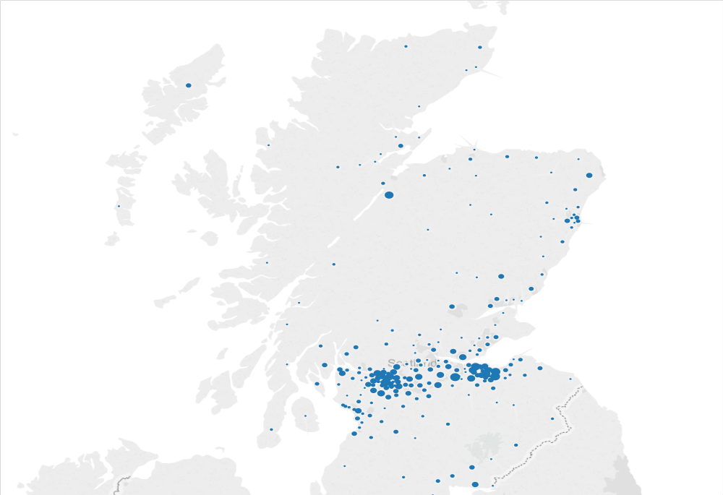
Geographical Location of Childhood VI (N=1289)

Slide 17
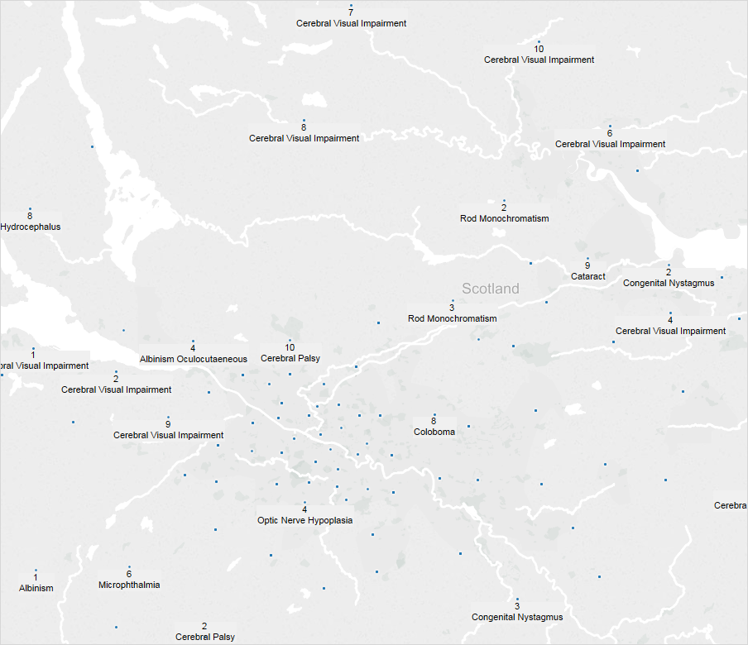
Where is VI? Geographical Markers

Slide 18
Diagnosis from N=805
89 Different Entries of Primary Diagnosis
CVI the most common 192 (23.8%)
Congenital Nystagmus 53 (6.5%)
Oculocutaneous Albinism 43 (5.3%)
Cataract 37 (4.59%)
Etc…….

Slide 19
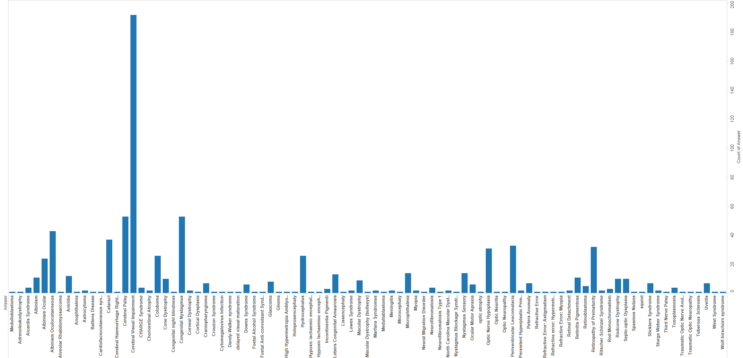
CVI (N=192) v (Rest of Primary Diagnosis)

Slide 20
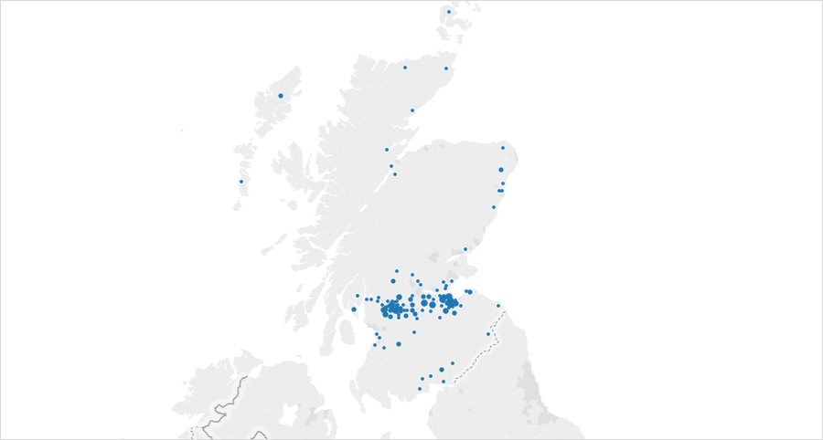
CVI in Scotland (N=192)

Slide 21
Where is CVI
So now using the data I know
Exactly where every child with CVI is
  What services they are/ are not getting
  Who is their QTVI / Ophthal / Paediatrician

Slide 22
Location then gives us access to SIMD
Scottish Index of Multiple Deprivation
The SIMD identifies small area concentrations of multiple deprivation across all of Scotland in a consistent way.

Slide 23
Remember for Scotland
1 = Most Deprived (20% Equal pop)
5 = Least Deprived (20% Equal pop)
1 = Most Deprived (10% Equal pop)
10= Least Deprived (10% Equal pop)

Slide 24
Childhood Visual Impairment and SIMD
Most Deprived
Least Deprived

Slide 25
VI ALL (including CVI )
No correlation to Social Deprivation
Pearson’s r: -0.48
It is not statistically significant (p = 0.1621; 95% CI: -0.85 to 0.22).
No correlation of VI (ALL) and Social Deprivation
Opposite finding to previous research

Slide 26
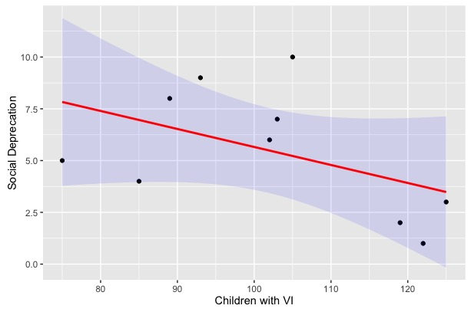
SIMD Decile and Childhood VI

Slide 27
VI ALL
(Not including CVI)
Pearson’s r for VI(w/o CVI) correlation is -0.28
The p-value is 0.4397. The 95% CI is -0.77 to 0.4
Even less of a correlation between VI and Social Deprivation

Slide 28
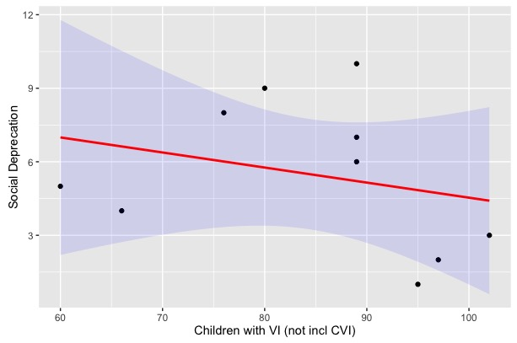

Slide 29
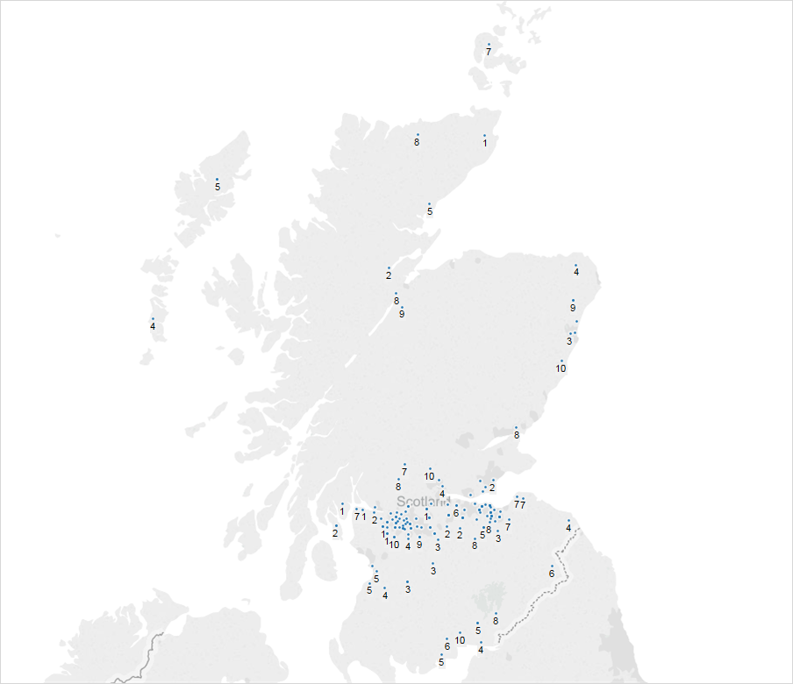
Childhood CVI and SIMD Index

Slide 30
Most Deprived
Least Deprived

Slide 31
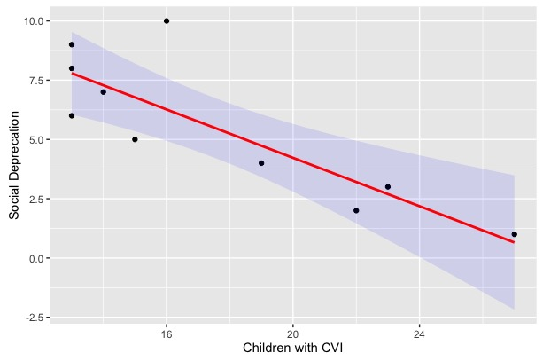
Childhood CVI and SIMD Decile (N175)

Slide 32
Statistically
Pearson’s r: -0.84, indicates a VERY STRONG relationship between CVI and Social Deprivation –
CVI is found more in the most deprived areas of Scotland based on equal number % deciles.
The p-value 0.0023! The 95% CI is –0.96 to –0.45.

Slide 33
Particularly the first 4 Deciles
Most Deprived
Least Deprived

Slide 34
Issues with VIS Data
Self notification
Large number of unknown diagnosis
Reliant on Ophthalmologists to confirm after notification
Errors could slip into process
Not representative of Scotland only those that want to notify –did so…..

Slide 35
VINCYP
NHS Scotland Clinical Network
Develop a more robust minimal CLINICAL dataset to improve service and financial planning in addition to supporting research.
Is now Scottish system of Childhood Registration

Slide 36
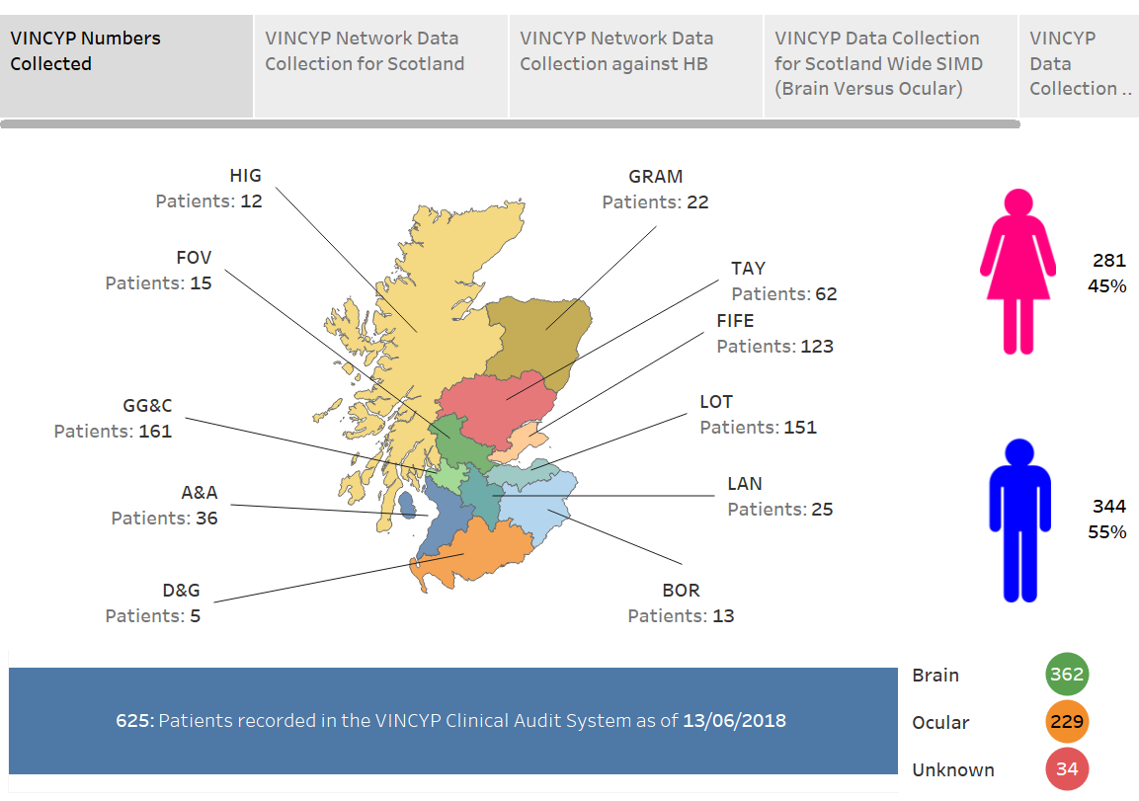

Slide 37
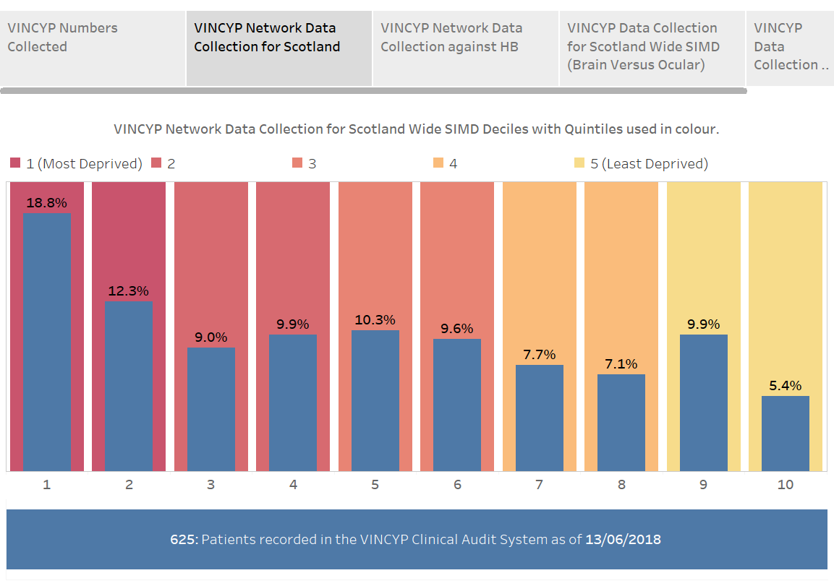

Slide 38
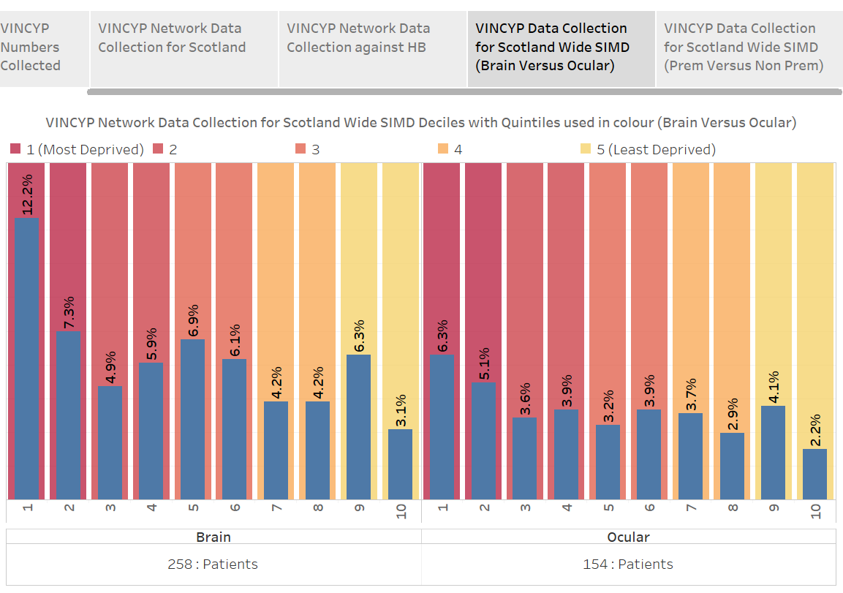

Slide 39
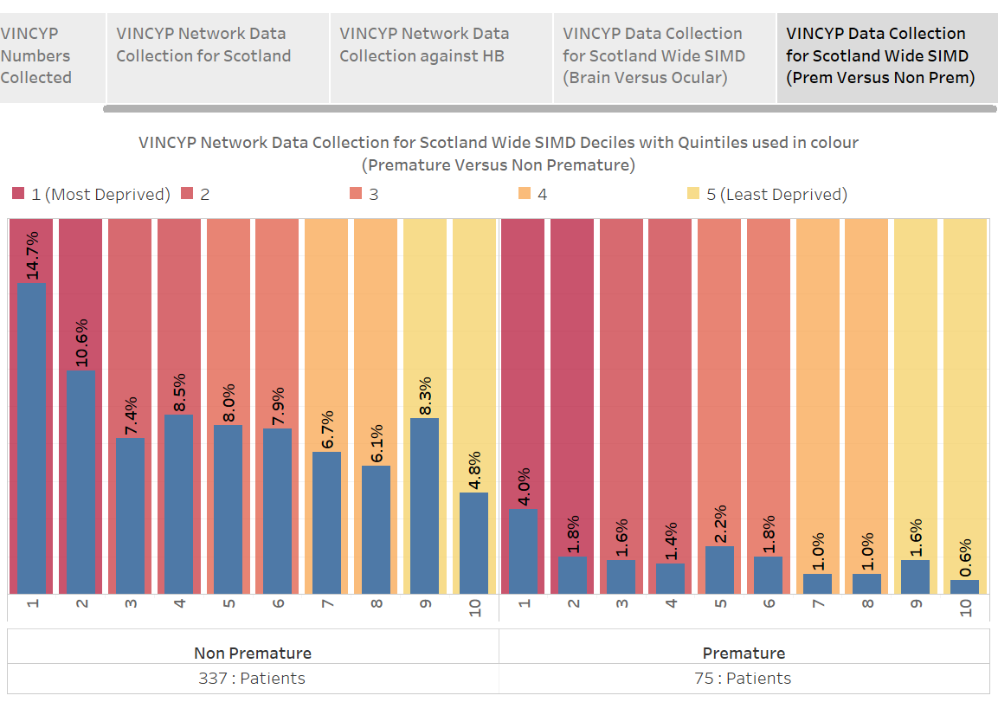

Slide 40
First pass
Poisson regression Analysis (R)
P<0.000*, Null deviance: 3079.5 on 6504 degrees of freedom, Residual deviance: 3048.5 on 6503 degrees of freedom
Significant likelihood to find a child with VI in the most deprived areas of Scotland

Slide 41
Possible Causes ?
Prematurity / Low birth weight
Maternal Health
Diet
Smoking
Drugs
Epigenetics

Slide 42
Conclusion: Health and Wellbeing.
Need to take very seriously social deprivation and visual impairment and in particular brain related visual pathway impairment – (CVI)
Significant public health concern that moves away from just the “visual” impairment” but should take a holistic community approach to service planning, support to improve the comes of children.

Slide 43
Thank you
Professor John Ravenscroft
John.Ravenscroft@ed.ac.uk

