Slide 1
Optometry’s role in the identification and management of individuals with vision impairment secondary to brain damage
2018 AER International Conference
NVI Preconference
Barry S Kran, OD, FAAO
Reno, Nevada
25 July 2018

Slide 2
Overview/Goals
Build on what has been presented
Share how a functional, (re)habilitative and patient centric approach to patient care can provide:
  Vision function and functional vision information
  Habilitation strategies
  Advocacy
  Education
  for care givers and children with NVI
Answer questions posed by organizers of the preconference

Slide 3
Questions to address
How do you propose that more children be diagnosed with CVI in the US?
For children in academic programs who may have CVI, how do you feel they can best be identified and served?
Is CVI or poor visual-perceptual development due to severe ocular-motor dysfunction? How to access?
Is it realistic to believe that having this information will ever be the norm?
How are all groups classified abroad? What are your definitions? Is world consensus possible?

Slide 4
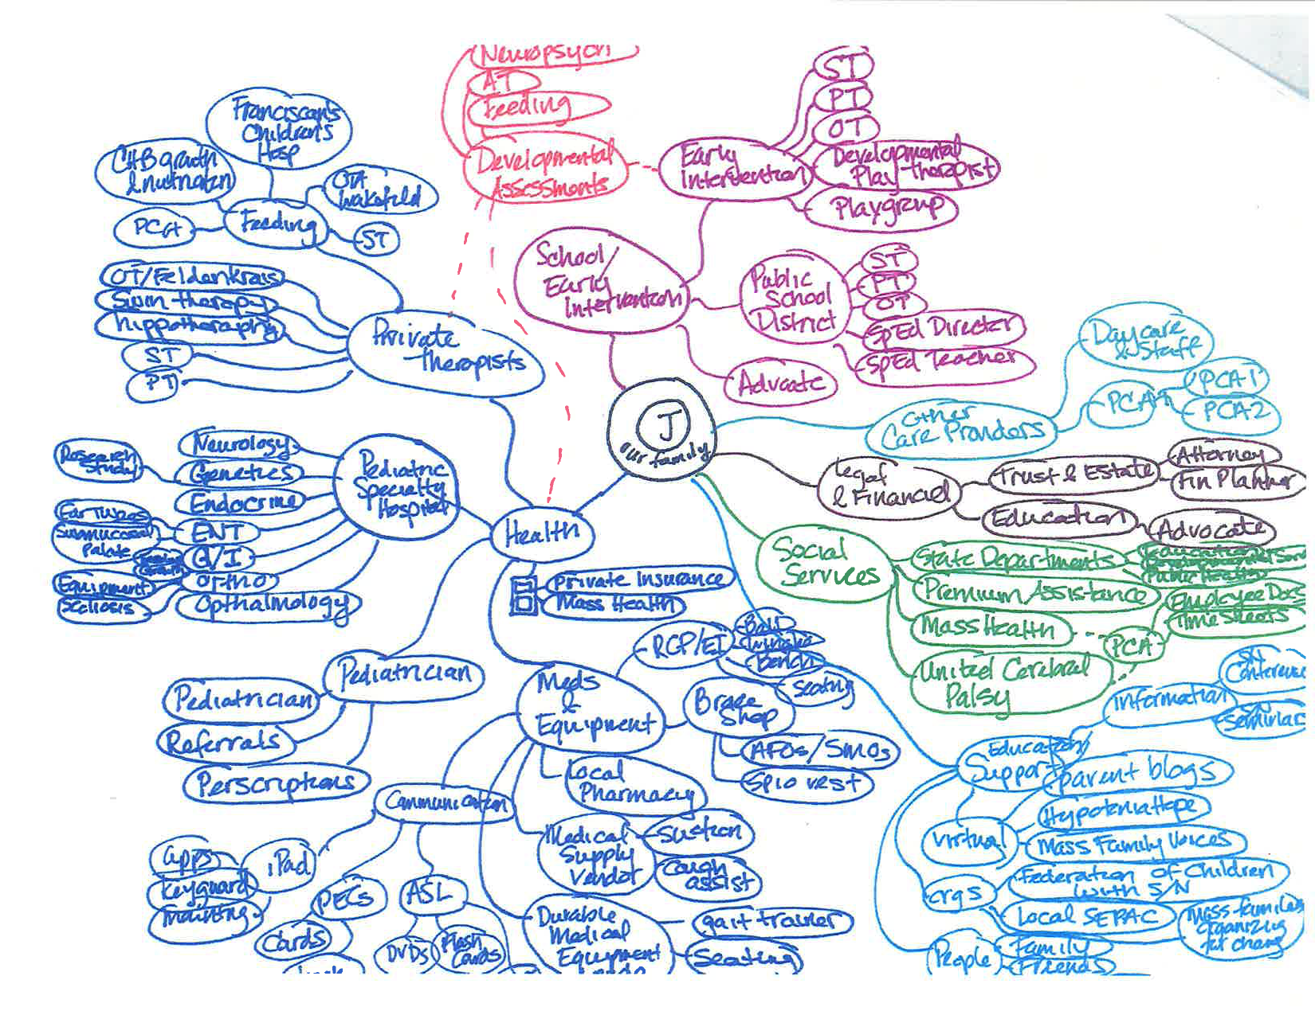
Are all children with CVI like J?
Notes:
The “C” first and foremost stands for the child and their family. Note how the child is in the center! Point out areas of the flowchart to the audience. It can take a village to raise a child.

Slide 5
Should there be subcategories of CVI?
We don’t know what we don’t know.
  We talk about prototypical low, moderate and high functioning individuals with CVI but what about other overlying issues impacting receptive and expressive learning and communication?
  Negative implications to categorizing too early
Be broad now and be sure that ALL have the option for ID and provision of services.
  The larger issue appears to be the definition of VI and legal blindness as this can be a barrier to provision of services to many individuals with CVI who have good vision function but poor functional vision.

Slide 6
What is the “C” in CVI
Functional definition
  “Vision impairment due to damage or disorder of the visual pathways and visual centers in the brain, including the pathways serving visual perception, cognition, and visual guidance of movement.” and may coexist with anterior visual pathway anomalies
    Dutton GN, Lueck AH. Editors. Impairment of vision due to damage to the brain in Vision and the Brain
    2015 AFB Press Page 4
Most recent published definition based upon lit review
  “Childhood cerebral visual impairment is a verifiable visual dysfunction which cannot be attributed to disorders of the anterior visual pathway or any potentially co-occurring ocular impairment.”
    Sakki HE A, Dale NJ, Sargent J, et al. Br J Ophthalmol Published first online November 20, 2017. doi:10.1136/bjophthalmol-2017-310694

Slide 7
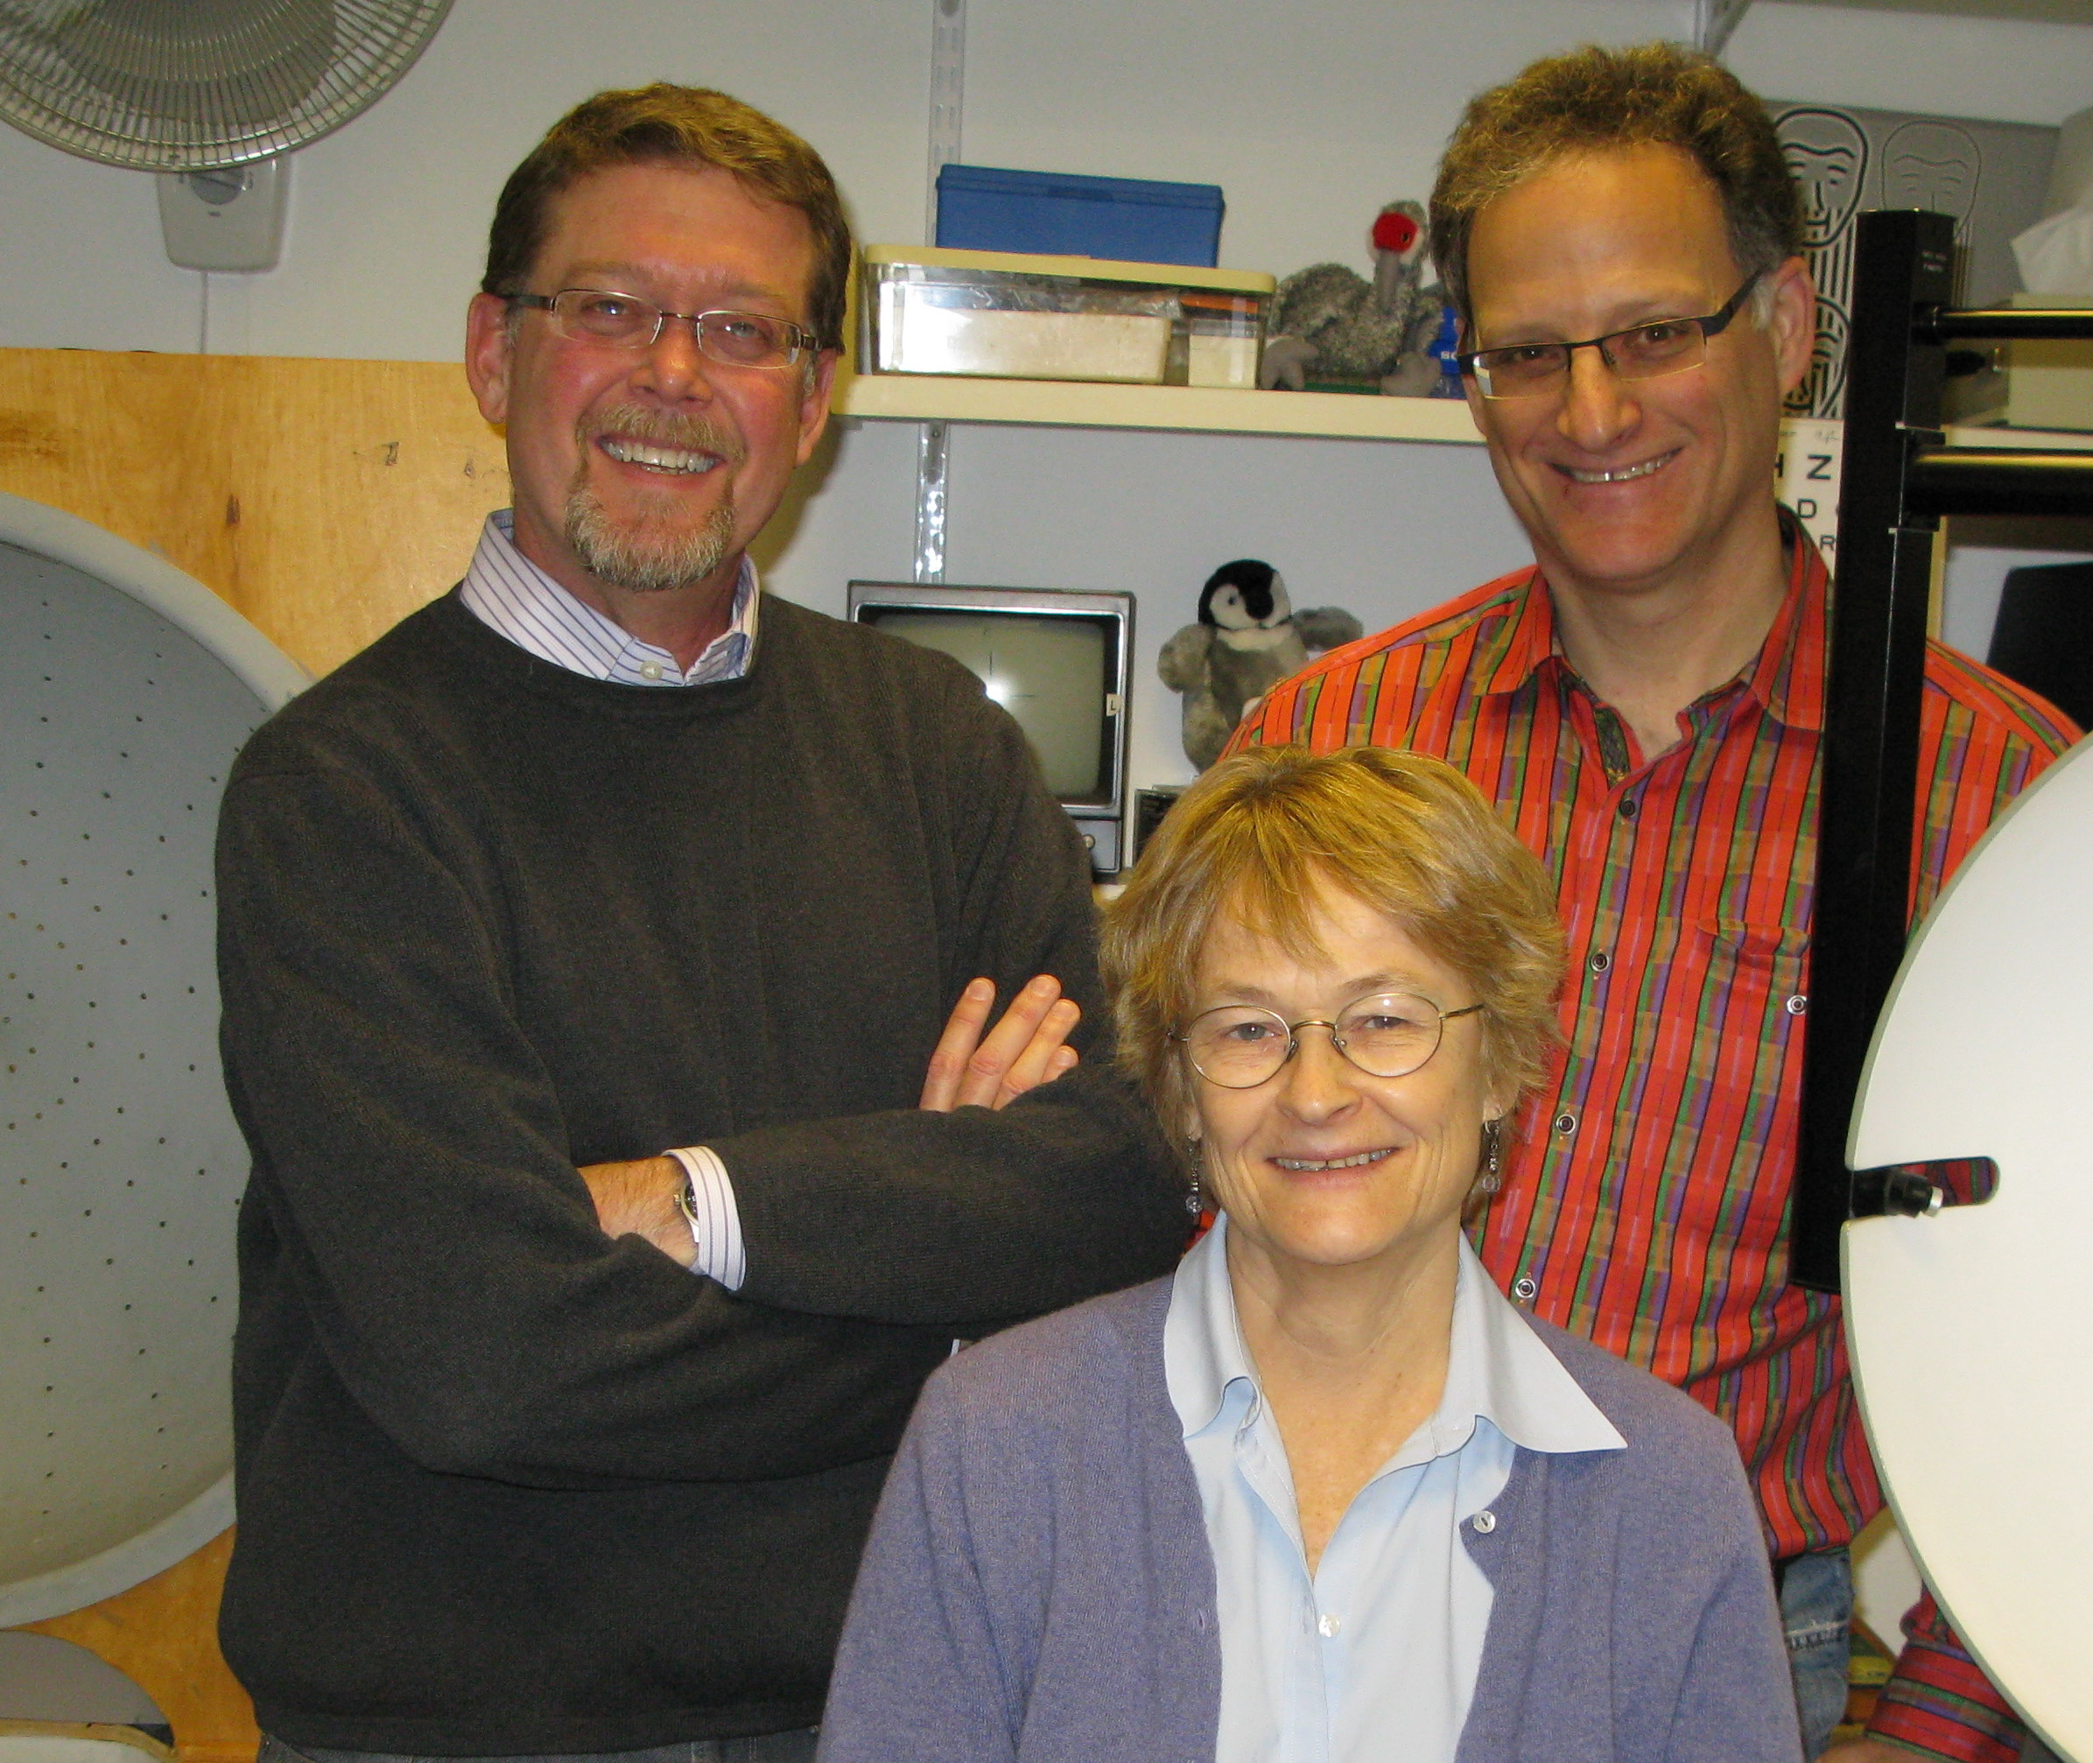
NE Eye Eye Perkins LV Clinic
30+ year collaboration between NECO & Perkins
Incredible colleagues
  Darick W Wright, MA, COMS, CLVT
  D Luisa Mayer, PhD
  Nicole Ross, OD
  Liaisons

Slide 8
Our clinic
Has become a site which interfaces between medicine/eye care and education. Must be familiar with info and implications of findings from both worlds and tailor an evaluation to address the needs of the child
  Referrals from
    Vision educators from throughout New England and beyond
    Pediatric ophthalmologists
    Pediatric physiatrists
    Pediatric neurologists
    Speech and Language specialists

Slide 9
Our clinic
Due to our training, approach to care, and collaboration with others, we:
  Obtain data that other eye care providers are unable to obtain
  Provide standard low vision evaluations and interventions
  Provide clinical functional low vision evaluations which include
    Perimetry, vision function, functional vision information
Reports/Advocacy
    Written in a way that parents and educators will understand with links as needed
    Explanation of additional diagnoses
    Provide education, treatment options and advocacy

Slide 10
How is this accomplished?

Slide 11
Paradigm shift: Adjusting the exam
It is not the patient who is uncooperative. Rather, the issue is the doctor’s inability to create an environment in which the patient can be successful.
It is not only how one introduces or models and adapts a technique, but when one performs the technique during the exam that will ultimately determine one’s success in acquiring that information.
  It’s performing the right test at the right time and the right way!

Slide 12
Prior to seeing a patient who may have CVI…
Review all records and develop a game plan
  What, in the information reviewed prior to the visit, alerts for the possibility of CVI? Try to be objective; not vision system centric.
  Which findings might be significant in contributing to a better understanding of how the patient “sees and uses their vision”?
    How might these findings be best obtained?
    Use of surveys and directed history questions
    Vision function vs. functional vision

Slide 13
Patient History / Causes of CVI
Maternal health
Pregnancy – term or not, complications during pregnancy
Anything which can cause inflammation in the developing fetus or perinatally
  Infection
  Anoxia/hypoxia
  Trauma
Seizures
Genetic – those that do impact biochemical pathways in the brain and some that do not but impact function
Abnormal development without an identified cause
Presence of CP or hypo/hypertonicity

Slide 14
History – Presenting concerns
Expressed concerns of parents and others
  What does my child see?
  Is there a problem with peripheral vision?
  How can we improve use of vision?
    for ADLs, Communication, Learning, other
  What should print size or symbol size be? How many symbols on a screen?

Slide 15
Additional History: Surveys
Surveys
  Dutton
    Validation reference: Philip SS, Tsherlinga S, Thomas MM, Dutton GN, Bowman R. A validation of and Examination Protocol for Cerebral Vision Impairment Among Children in a Clinical Population in India J Clin Diag Res 2016 vol10(12): NCO1-4
  Ortibus
    Ortibus E, et al. Screening for cerebral visual impairment: value of a CVI questionnaire. Neuropediatrics 2011 Aug;42(4):138-47
    https://www.teachcvi.net/screening-tools Accessed 29 Aug 2017
  Israeli
    Ferziger NB, Nemet P, Brezner A, Feldman R, Galili G Zivotofsky A. Visual assessment in children with cerebral palsy: implementation of a functional questionnaire Develop Med & Child Neuro 2011, 53:422-428
Notes:
Surveys should not be the sole basis upon for determining the a diagnosis of CVI
Surveys are helpful to direct the examination or to highlight areas for further assessment in your office or elsewhere
NOTE: Teach CVI also has key questions or screeners as they are termed

Slide 16
Directed History Questions
  Q2. Does your child have difficulty walking down stairs?
  Q18. Does your child have difficulty seeing things which are moving quickly, such as small animals?
  Q19. Does your child have difficulty seeing something which is pointed out in the distance?
  Q24. Does your child have difficulty locating an item of clothing in a pile of clothes?
  Q27. Does your child find copying words or drawings time consuming and difficult?
Dutton GN, Calvert J, Ibrahim H, Macdonald E, McCulloch D, MacIntyre-Beon, Spowart KM. (2010)
Structured history taking for cognitive and perceptual dysfunction and for profound visual difficulties due to damage
to the brain in children. In: Visual Impairment in Children Due to Damage to the Brain
Eds: Dutton GN, Bax M. MacKeith Press. London. pp117-129.

Slide 17
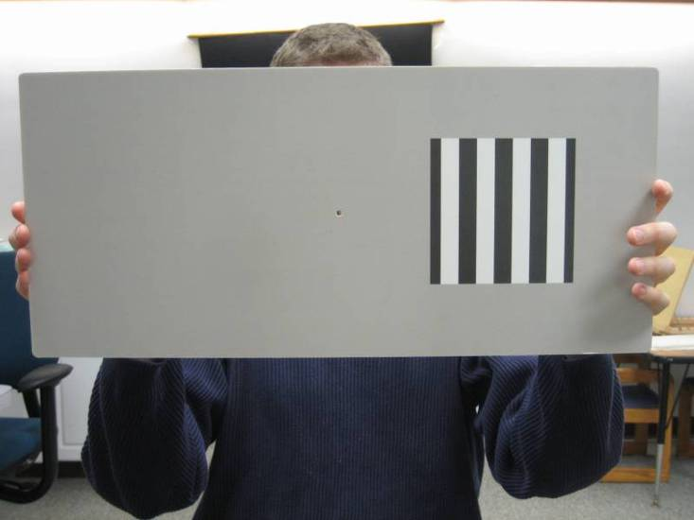
Acuity Measures
Grating acuity versus Recognition acuity
  Large stimulus, not content related
    Detection vs. recognition
  Near vs. Distance VA
  Grating acuity tends to overestimate recognition acuity
https://www.schoolhealth.com/lea-symbols-and-hotv-
combination-flash-cards Accessed 25 March 2018

Slide 18

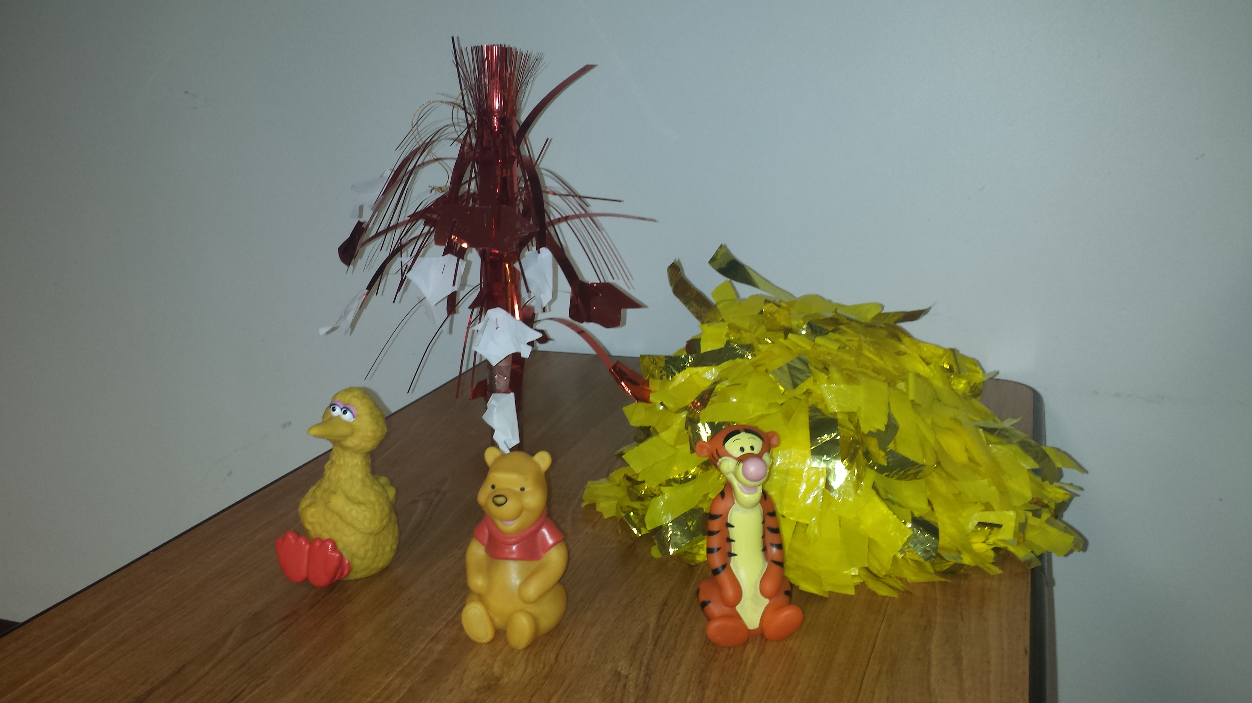
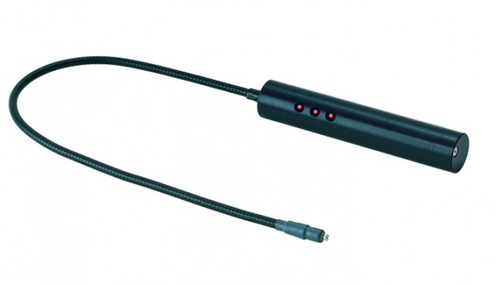
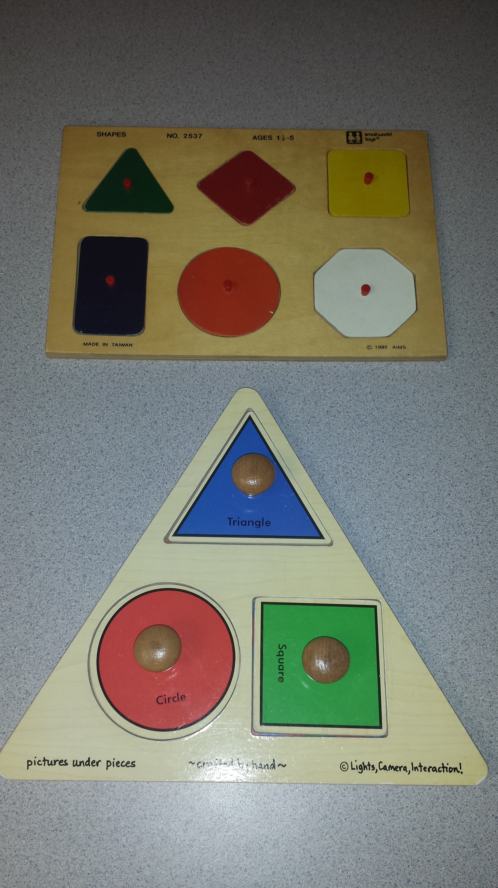
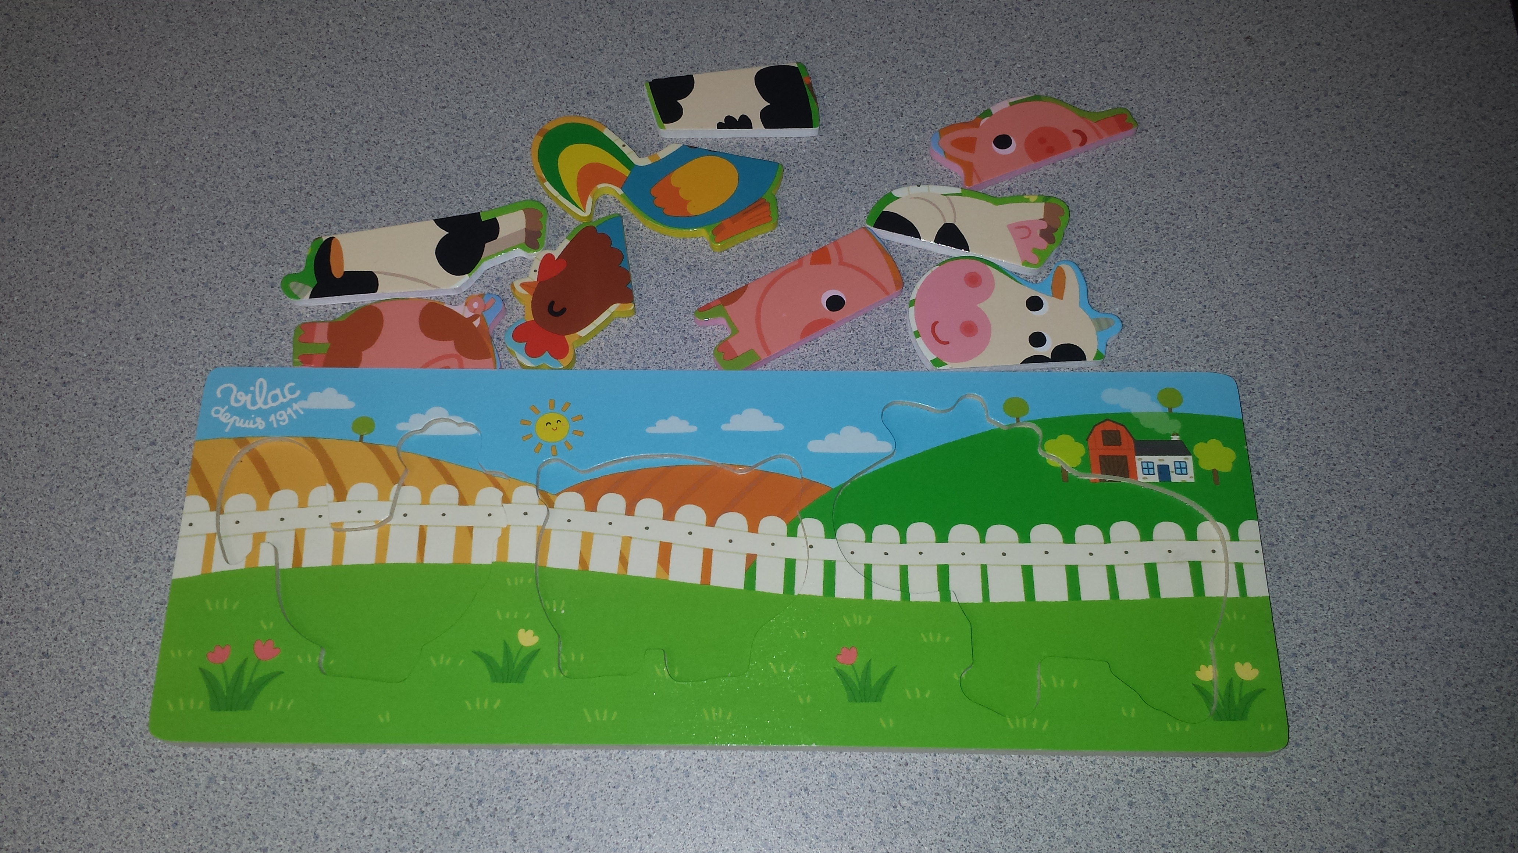
Examples of out-of-the-box testing
Contrast – preferential looking
Modified dynamic retinoscopy
Visual Field
Puzzles
https://www.goodlite.com/Details.cfm?ProdID=44
Accessed 29 August, 2017

Slide 19
Examination Outcomes/Habilitation
Use data and observations to implement a treatment plan to address concerns
  Spectacles, LV devices, e-magnification, referral for Neuro-psych, determination of initial print size, referral for learning media assessment
  Someone transitioning from EI to preschool who needed a visually quiet room to engage vision and needed frequent visual breaks
  Someone who is transitioning from lower school to middle school and can not cross a street or recognize familiar people
  Someone who is non-verbal and has a sense of cause and effect, family, and others are wondering about using vision as part of a communication system
Notes:
Vision therapy
Kress NE. Vision Therapy in the Cerebral Palsy Population: Utilizing Vision Therapy Techniques to Remediate Motor and Sensory Deficits of the Visual System. Optom & Vis Perf 2015;3(5): 406-15

Slide 20
Questions to address

Slide 21
How do you propose that more children be diagnosed with CVI in the US?
  Educate future and current pediatricians and pediatric neurologists
    Provide in-house education during medical training and on-going grand rounds, share information with reports
    Publish in journals they will read
  Educate current and future eye care providers and vision educators
    Lectures (live/on-line), clinical experience, textbooks, articles in professional journals, seminars at meetings, etc.
  Empower families; speak with parents
    Speak at EI conferences and involve state agencies and appropriate non-profits and advocacy groups

Slide 22
For children in academic programs who may have CVI, how do you feel they can best be identified and served?
  Through integration and communication between eye care providers and vision educators
  This is evolving
    Conferences such as this
    Recent AMESVI conference and BPS/NECO conference
    Perkins
Notes:
Association of MA Educators of Students with Visual Impairments

Slide 23
Is CVI or poor visual-perceptual development due to severe ocular-motor dysfunction? How to access?
  In general, one must be aware of the limitations of any one assessment tool. Typically several are necessary to differentiate any one condition from another.
  Both can exist separately and both can co-exist
  How is one defining OMD?
  There are motor and motor free visual perceptual tests that are one way of addressing this differential diagnosis.
  Experience.
    Are findings and function consistent with just an OMD or VP issue or both?

Slide 24
How are all groups classified abroad? What are your definitions? Is world consensus possible?
Challenging question
  As mentioned earlier, I prefer Amanda and Gordon’s definition of CVI and do not make further differentiation except as it relates to potential habilitation strategies for the specific patient
  Need to be careful that subtyping doesn’t create barriers for assessment and habilitation
Topic best left for an interactive conversation of the panel members and audience

Slide 25
Thanks
kranb@neco.edu

Slide 26
Resources & References

Slide 27
Resources for CVI
  Some CVI resource links
    cviscotland.org
      Parent site with accessible information. (Vetted by Gordon N Dutton)
      New (Summer 2018) printable guide for parents:
        https://cviscotland.org/downloads/CVIBookINT.pdf
    http://biomed.science.ulster.ac.uk/vision/-Visual-skills-inventories,60-.html
      Ideas for strategies for children of various ages and needs
    http://www.ssc.education.ed.ac.uk/resources/vi&multi/cpvi/ssreport.pdf
      Short document introducing CVI and important aspects
    https://cviscotland.org/downloads/CVIBookINT.pdf
      New parent resource from cviscotland.org.
    https//cvi.aphtech.org
      American Printing House for the Blind site on CVI

Slide 28
Resources for CVI
  Dennison E, Hall Lueck A eds. Proceedings Summit on Cerebral/Cortical Visual Impairment April 30, 2005 2006 AFB Press NY, NY
  Dutton GN, Bax M, editors. Clinics in developmental medicine no. 186: visual impairment in children due to damage to the brain. London: Mac Keith Press; 2010
  Hall Lueck A & Dutton GN eds Vision and the Brain. Understanding cerebral vision impairment in children. AFB Press 2015.
  Hayvarinen L, Jacob N. WHAT and HOW Does this Child See? Helsinki, Finland Vistest 2011
  Hoyt CS. Brain Injury and the Eye. Eye (2007) 21,1285-1289
  Kran BS, Mayer DL. Chapter 14 Vision impairment and brain damage in Taub, Bartuccio, Maino eds Visual diagnosis and care of the patient with special needs. Lippincott 2012
  Roman-Lanzky C. Cortical Visual Impairment: An approach to assessment and intervention 2nd Ed 2018 AFB Press NY, NY
  Zihl J, Dutton GN. Eds. Cerebral Visual Impairment in Children; visuoperceptive and visuocognitive disorders. Springer Wien 2015

