Slide 1
AER Division 3 & 19: Teaching Children with Moderate or Severe Disabilities
Lauren J. Lieberman Ph.D.
The College at Brockport
Department of Kinesiology
llieberman@brockport.edu

Slide 2
Who are we talking about?
…means concomitant [simultaneous] impairments (such as intellectual disability-blindness, intellectual disability-orthopedic impairment, etc.), the combination of which causes such severe educational needs that they cannot be accommodated in a special education program solely for one of the impairments. The term does not include deaf-blindness. [§300.8(c)(7)]

Slide 3
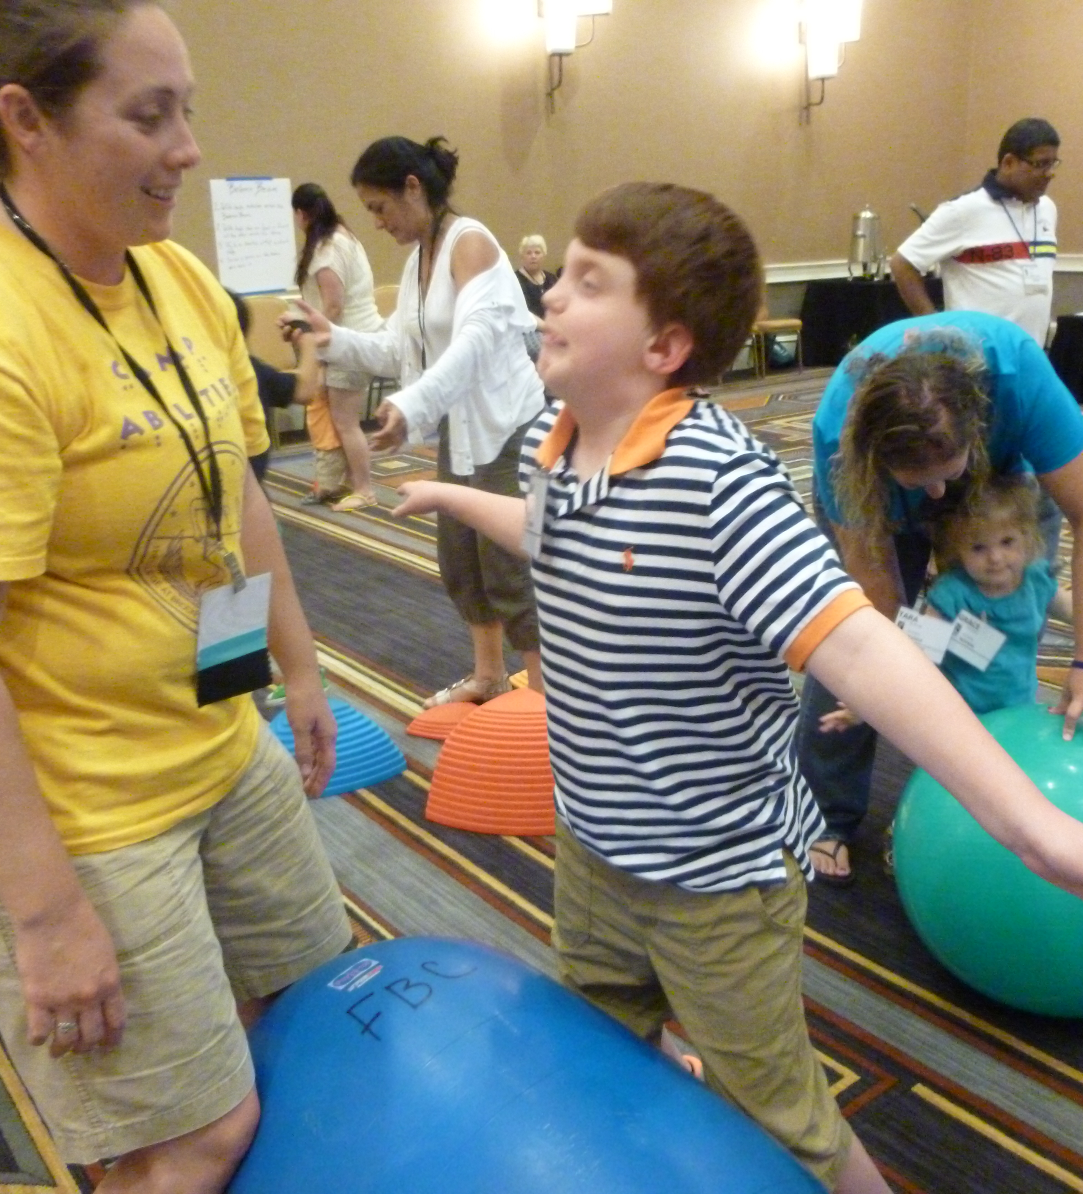
Causes of Severe Disabilities
Chromosomal abnormalities
Premature birth
Difficulties after birth
Poor development of the brain or spinal cord
Infections
Genetic disorders
Injuries from accidents (1)
Examples
  Trisomy 18
  Retts Disorder
  CHARGE Syndrome
  Severe autism

Slide 4
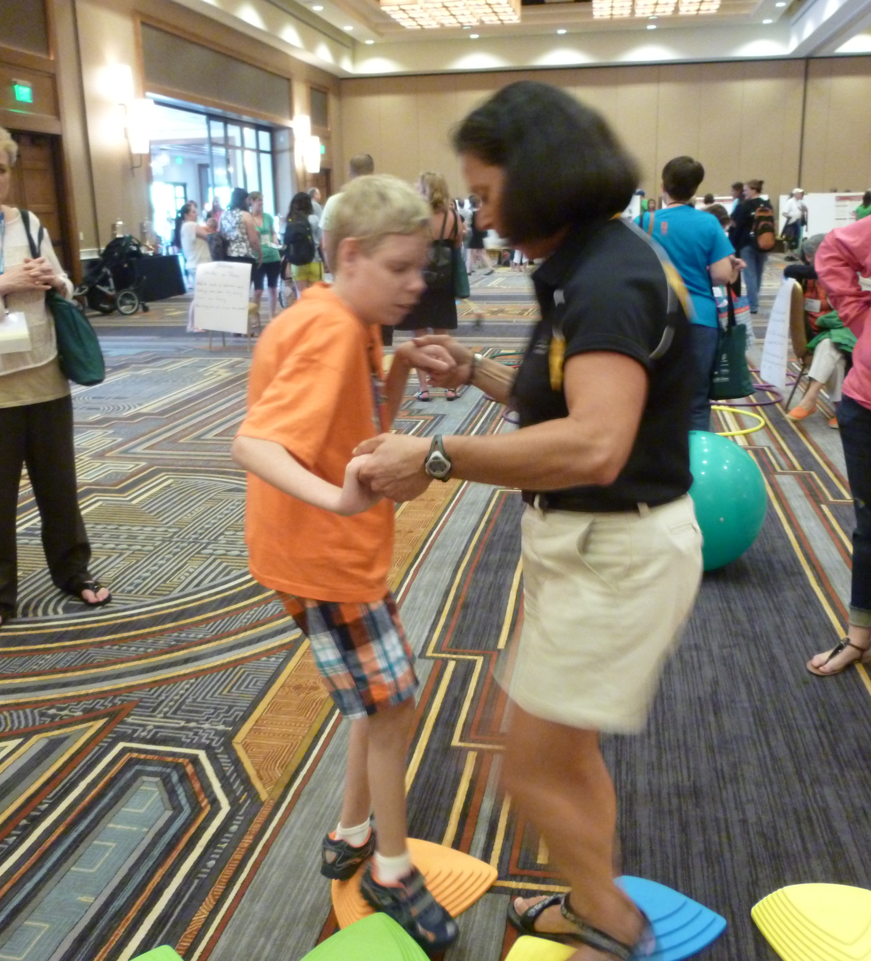
Issues
Levels of Awareness
Medical complications
Muscular imbalance and tension fluctuations
Seizures
Surgeries
Medications and side effects
Independence
Memory retention

Slide 5
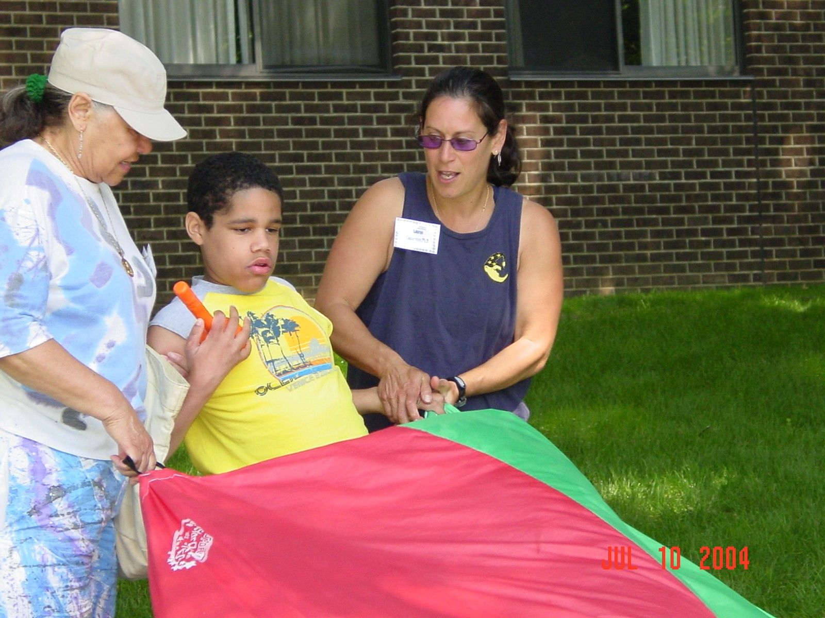
Goals of Physical Activity?
Sport and recreation participation
Activities of Daily Living
Independence
Decreasing dependence
Promote Socialization
Self-determination

Slide 6
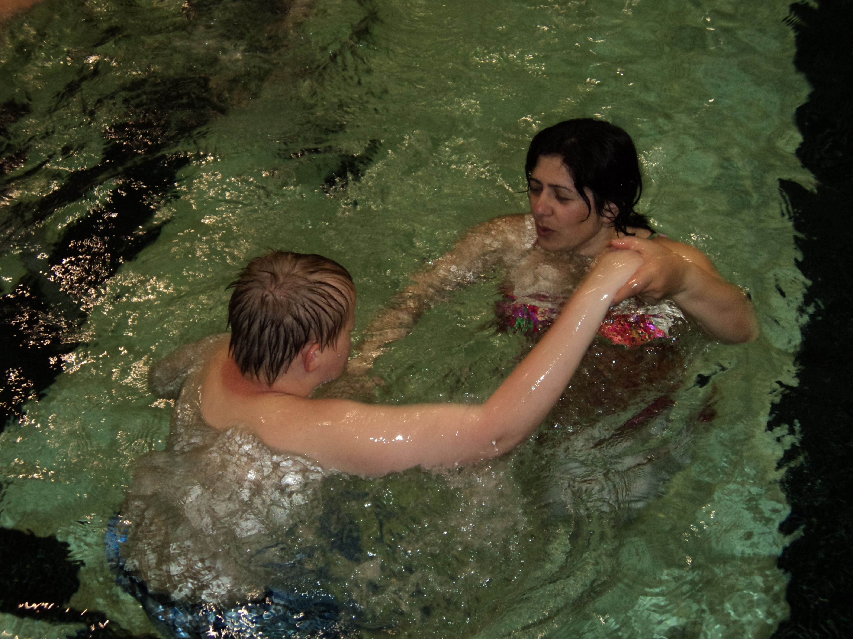
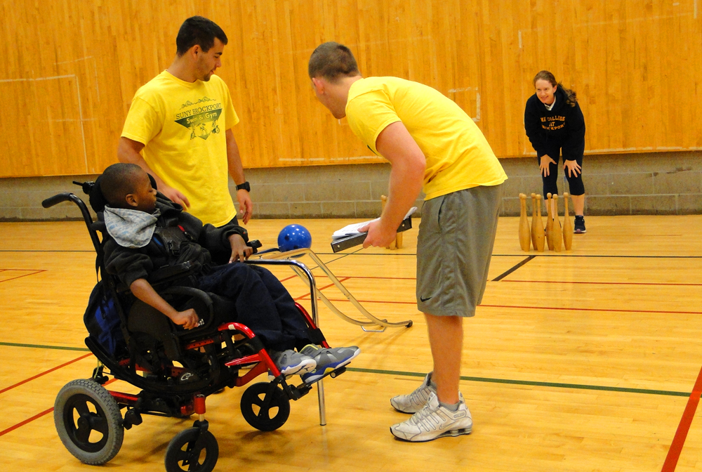
Top Down OR Bottom up Learning?

Slide 7
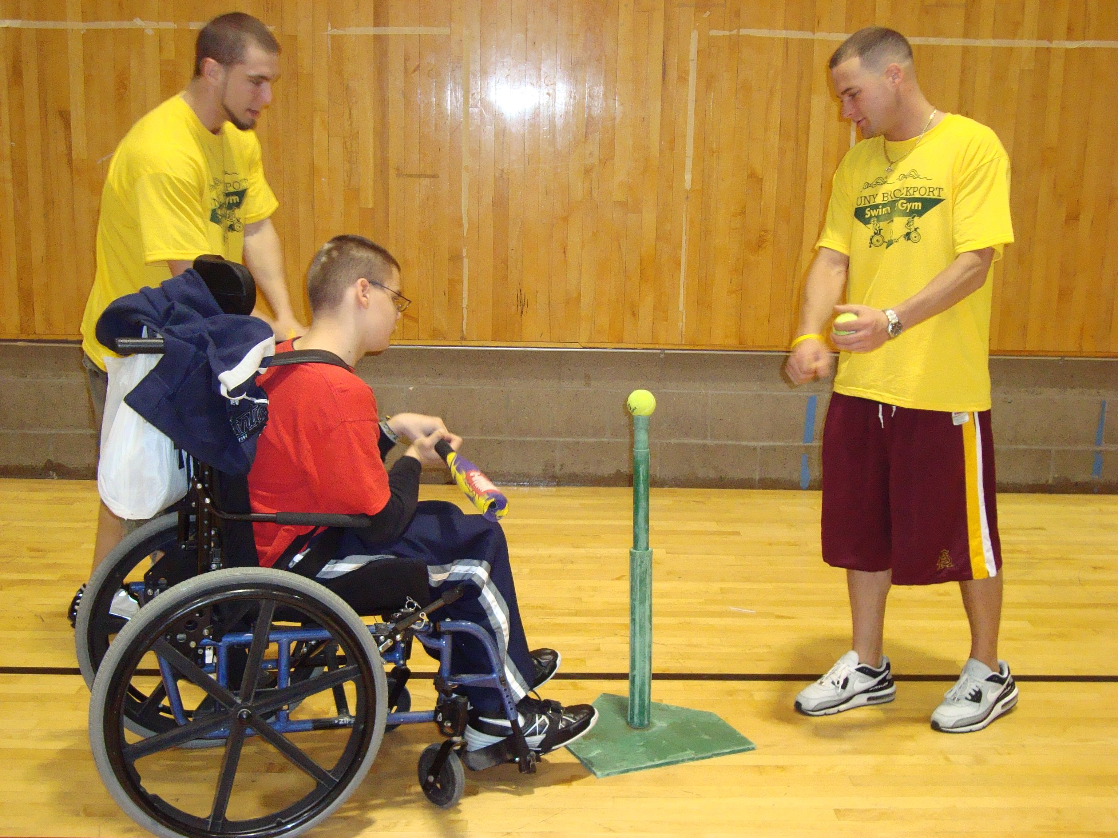
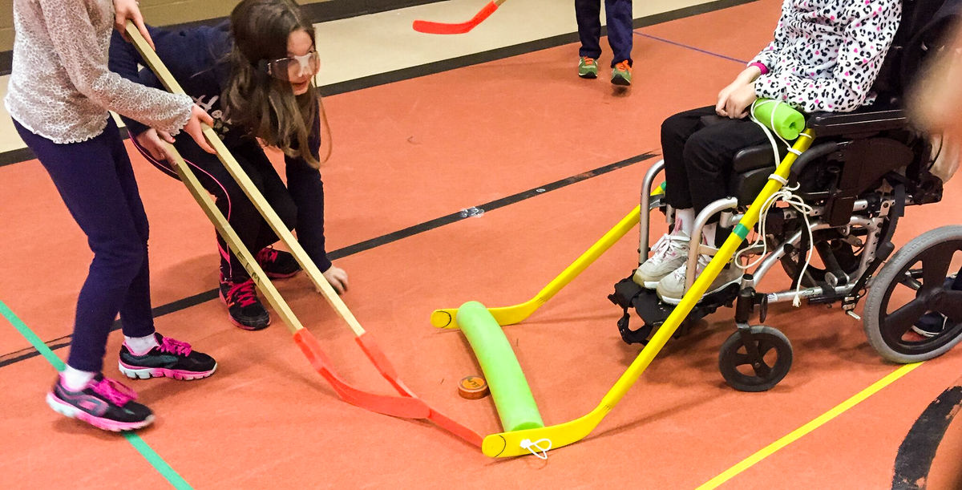
Top Down

Slide 8
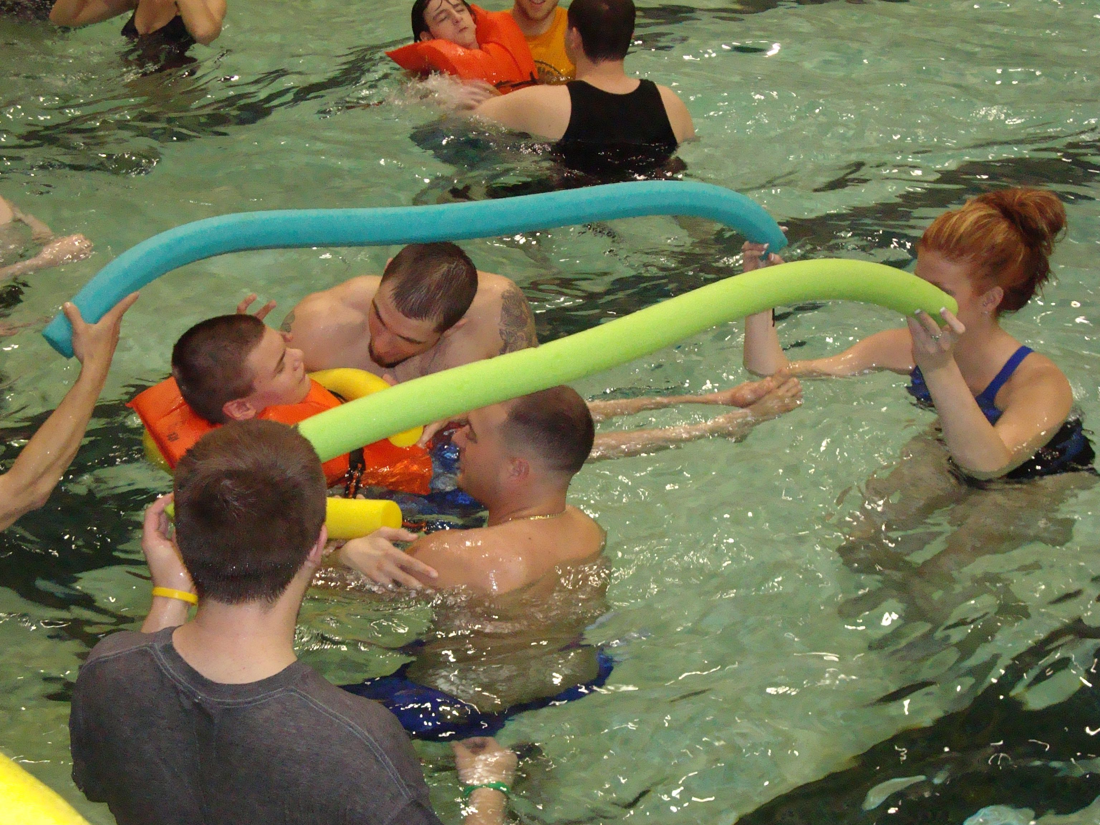
Top Down

Slide 9
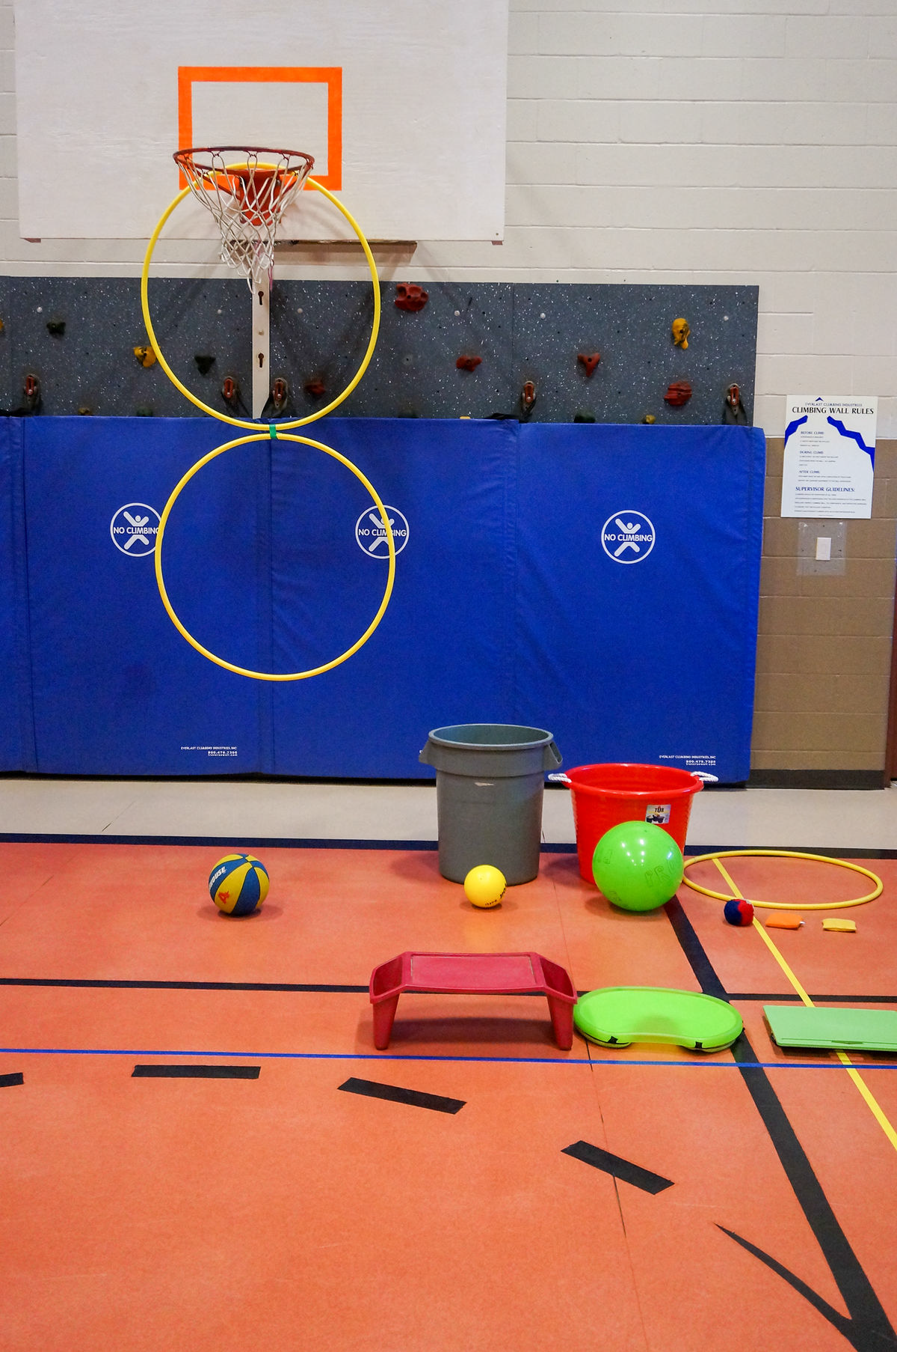
Universal Design for Learning

Slide 10
What do we assess?
Ambulation
Stability and trunk control
Grasp and releasing
Communication
Head control
AttentionFllexibility

Slide 11
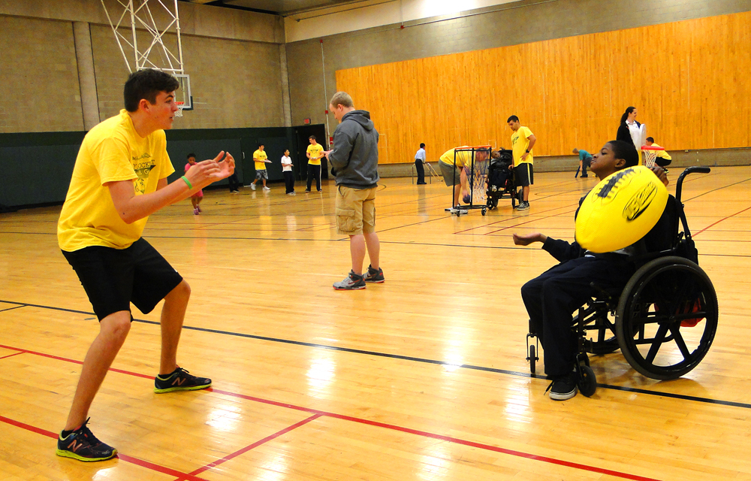
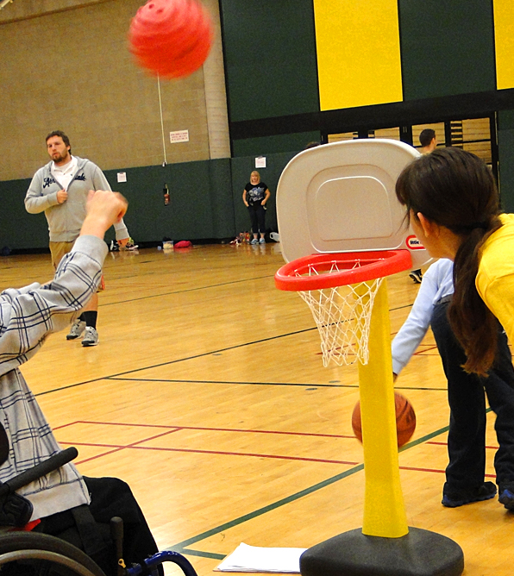
How would you assess these skills?
All are part of the GPE
Curriculum

Slide 12
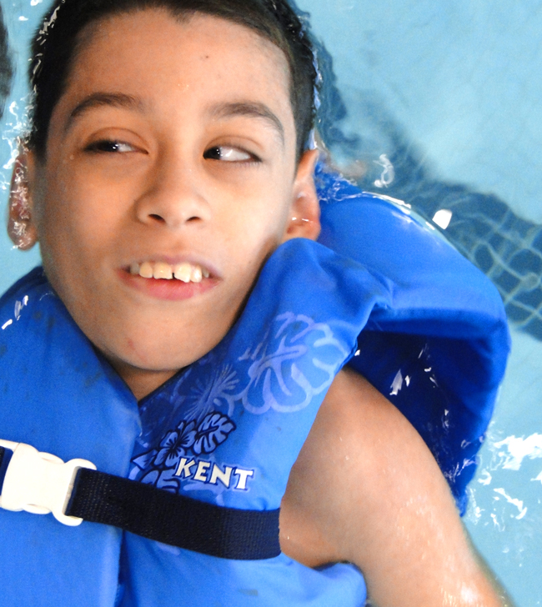
How do we determine improvements/learning/achievement?
Process
Product
Parameter

Slide 13
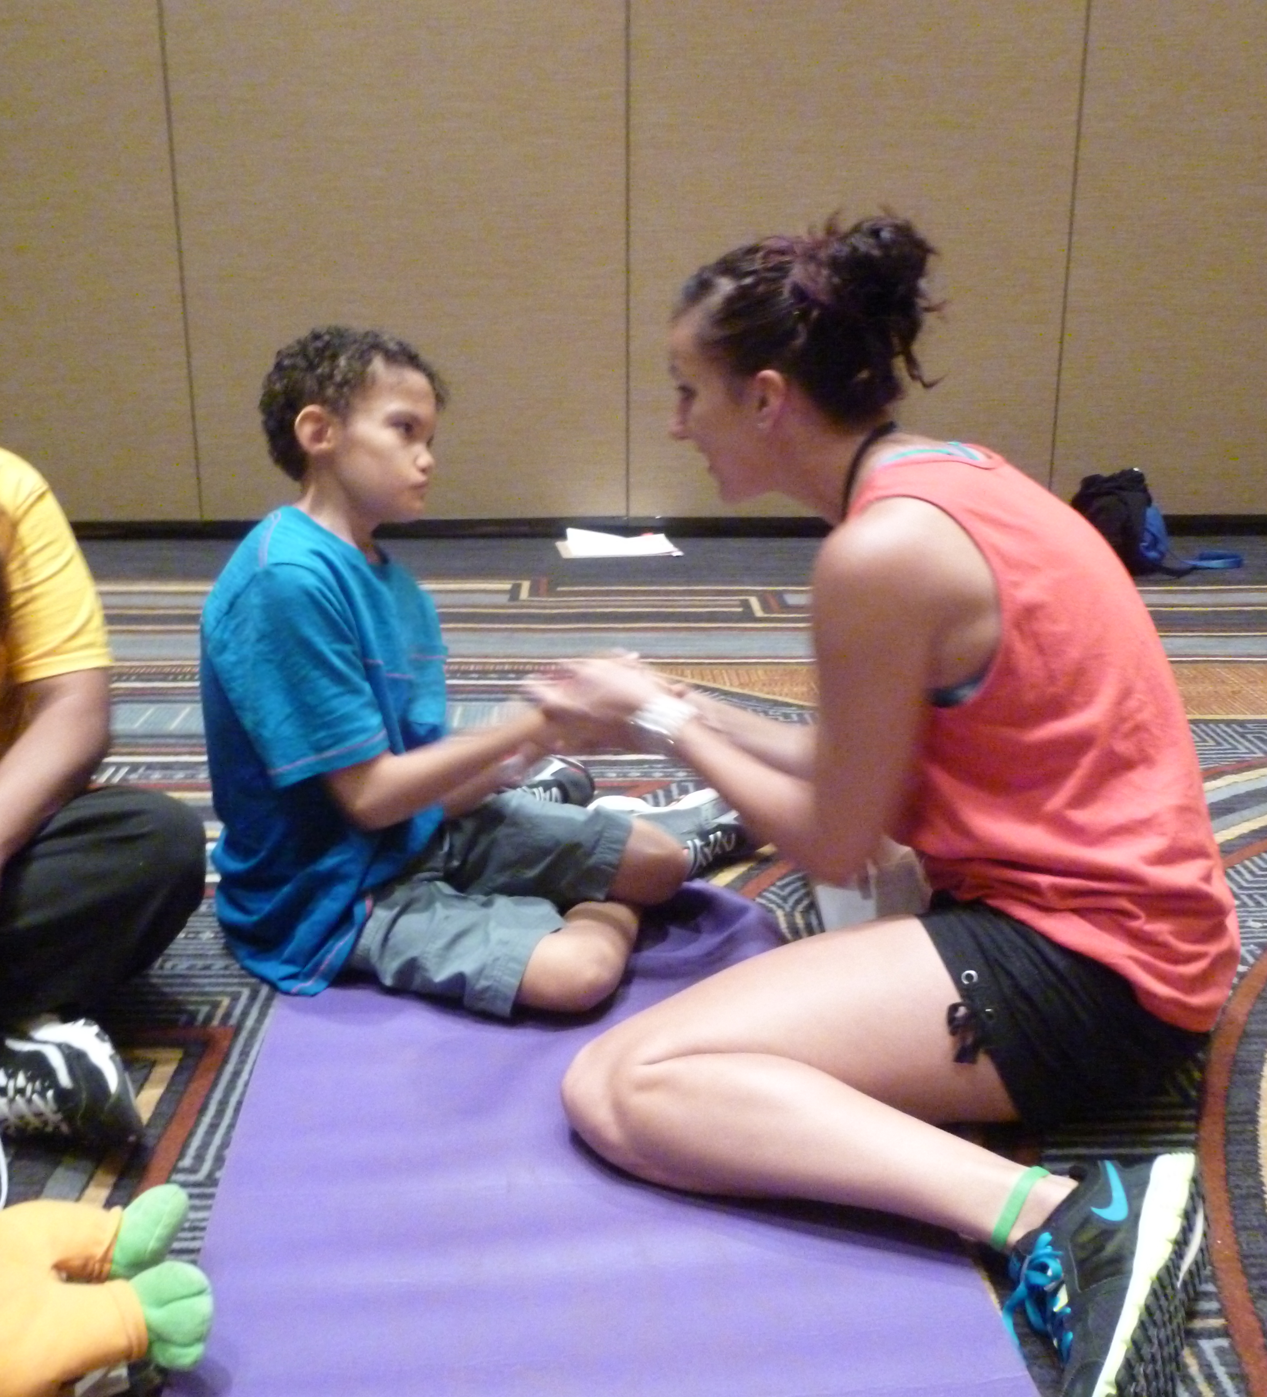
Assessment for Students with Severe disabilities
Level of Assistance
Process checklist
Percentile scores given

Slide 14
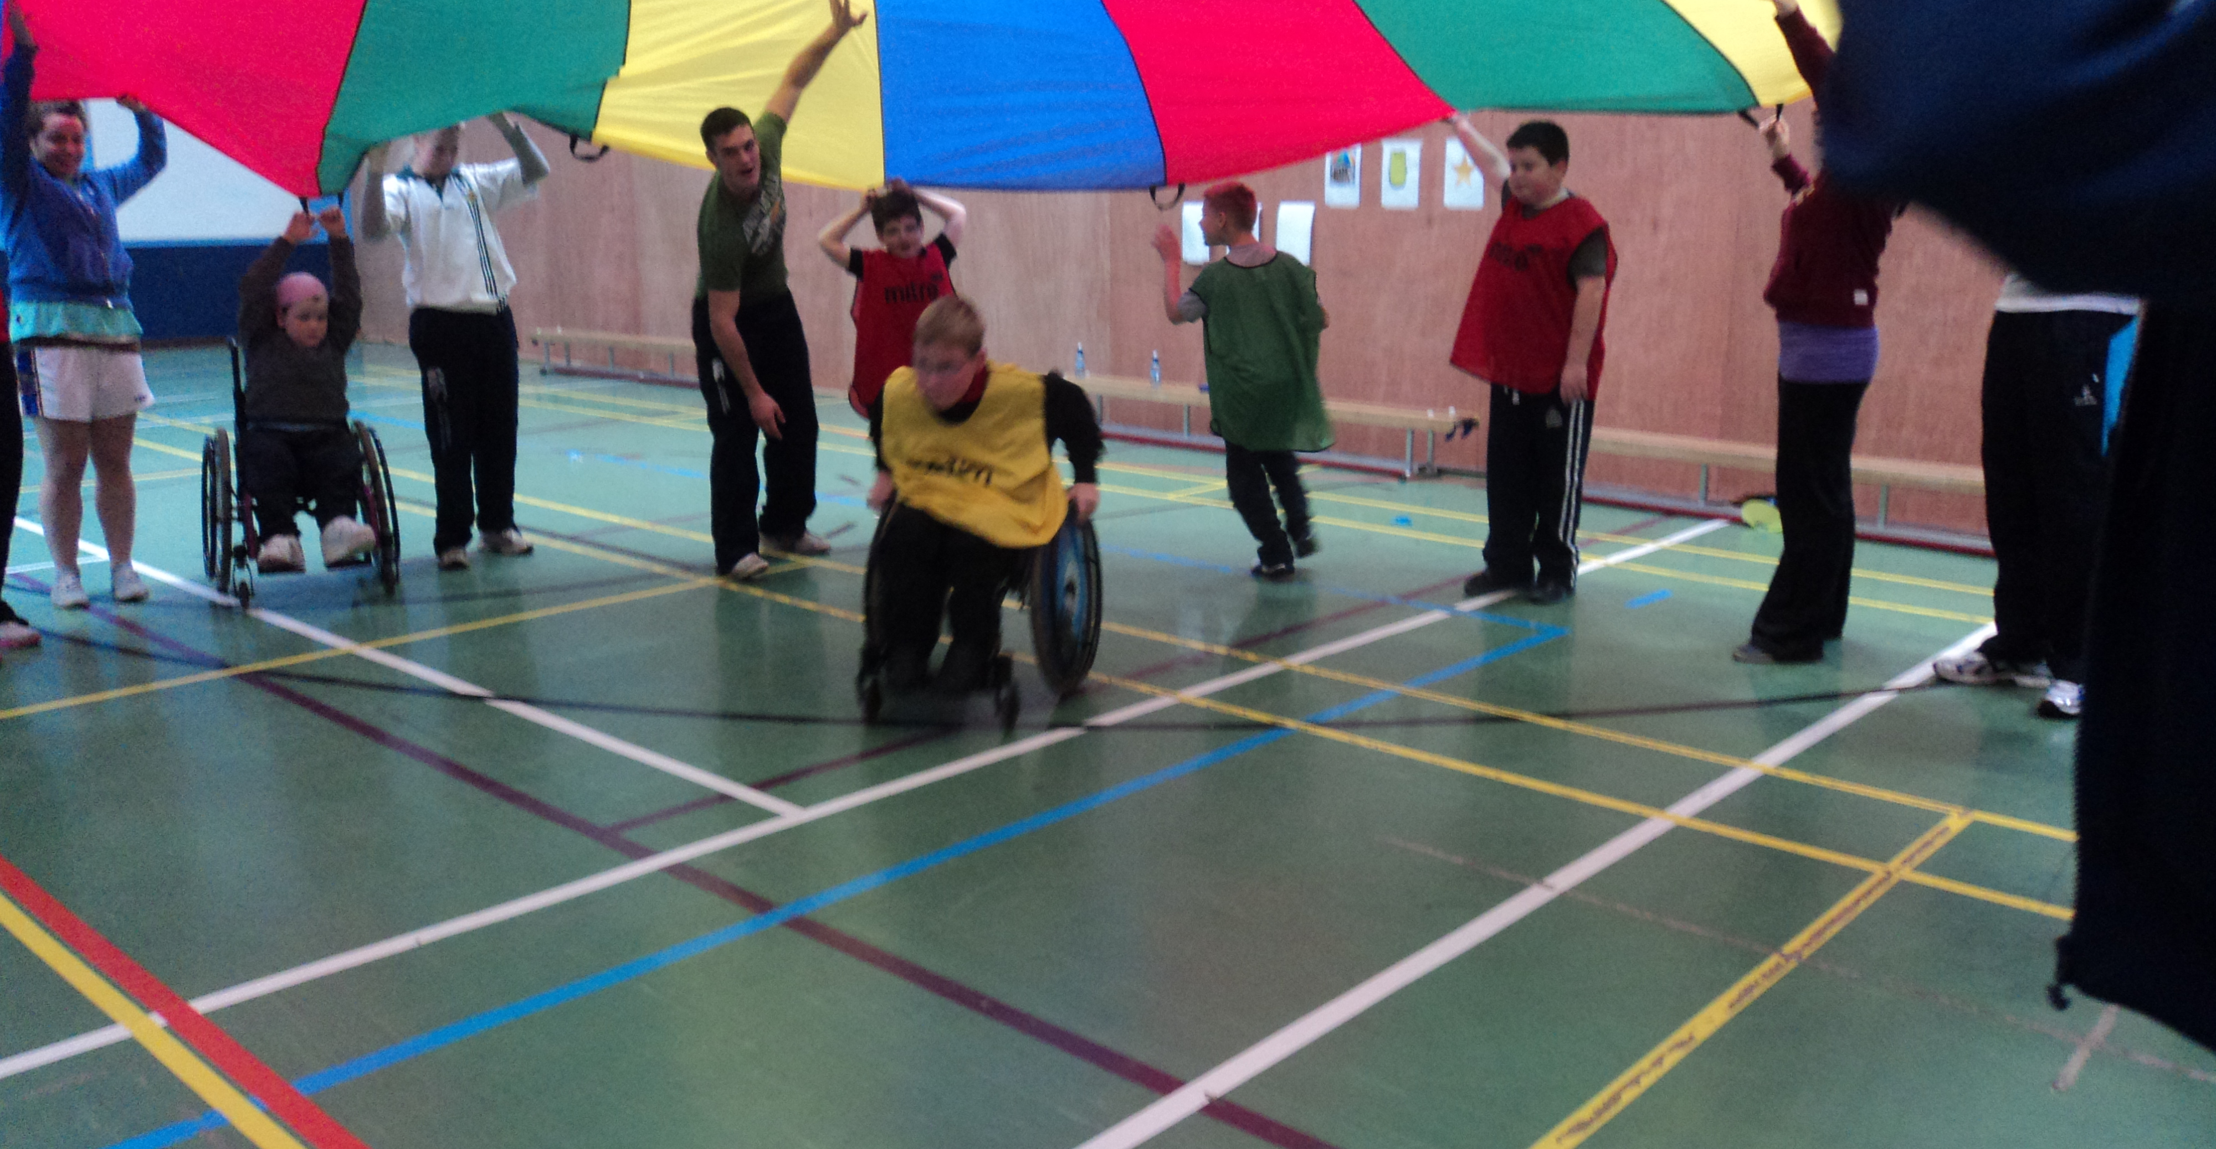
3 P’s for parachute?

Slide 15
Positioning
In wheelchair
Over Bolster
Over wedge mat
On mat
On a scooter
In the pool
Other?

Slide 16
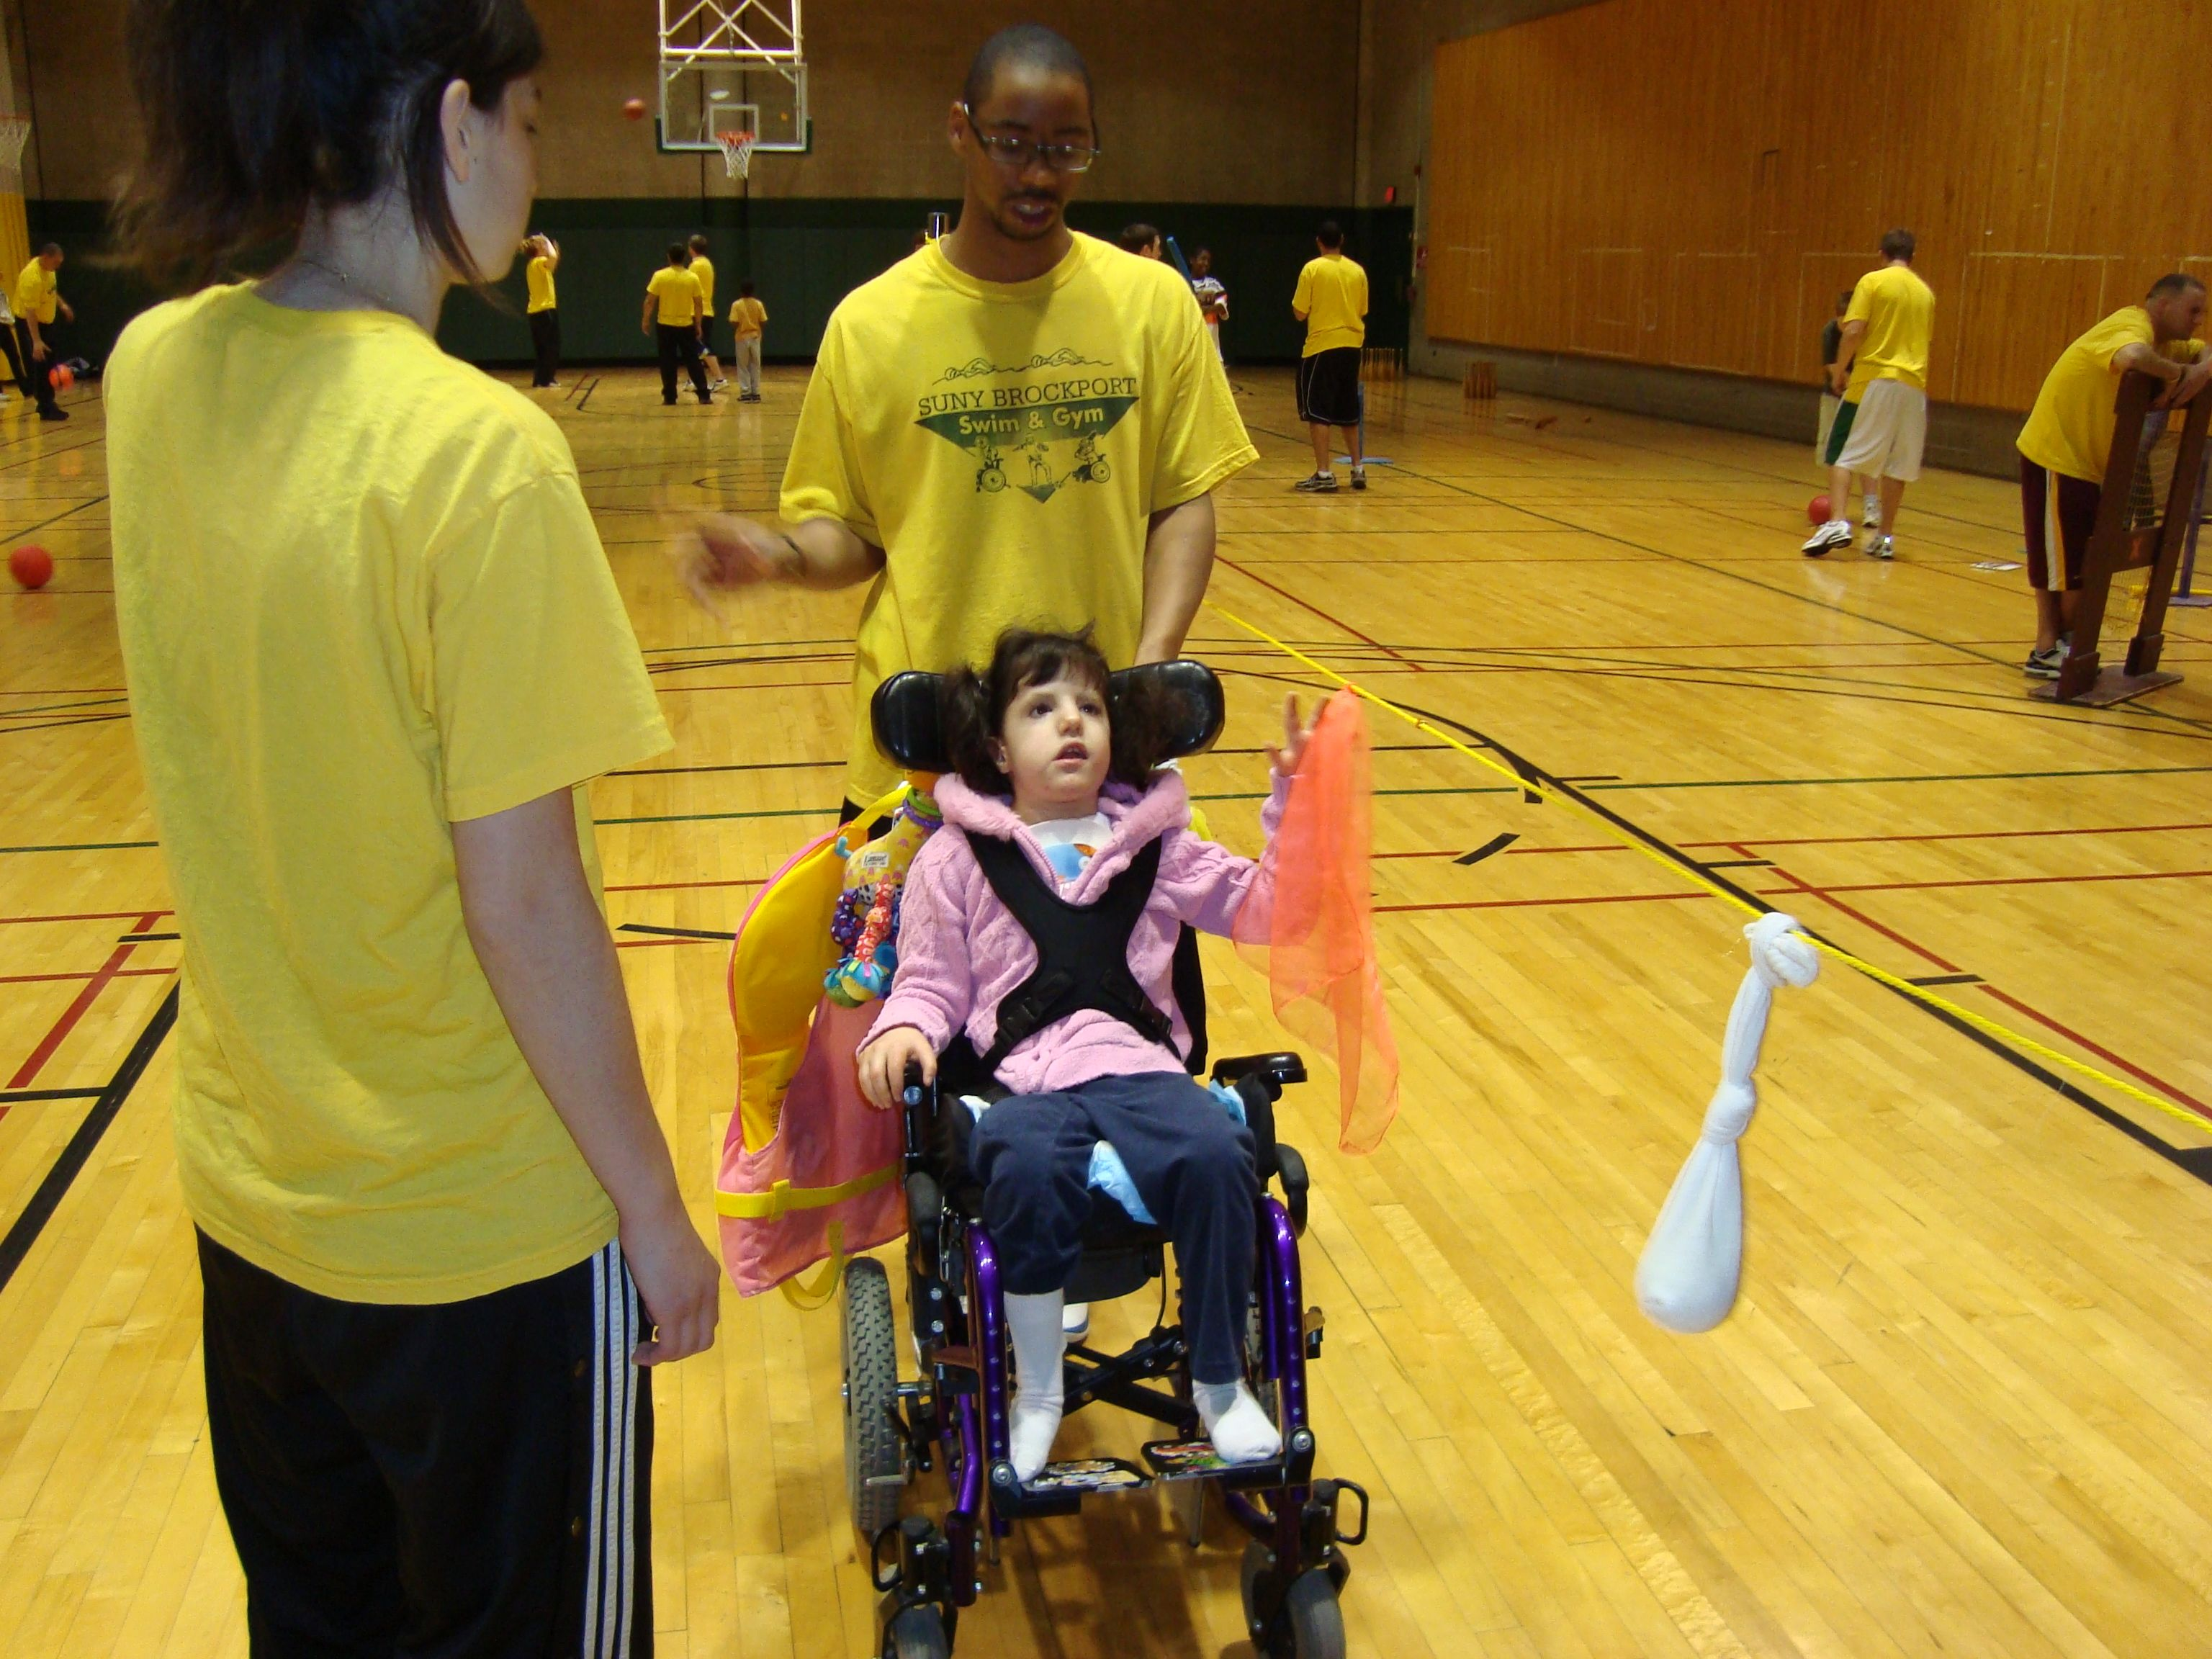
In their chairs
Student can push objects off of their laps
Student can reach for objects dangling from strings from the basketball hoop or from a string pulled across two volleyball standards. They can grasp items such as socks with a tennis ball inside, a tennis ball, scarves, waffle balls, or yarn or koosh balls.

Slide 17
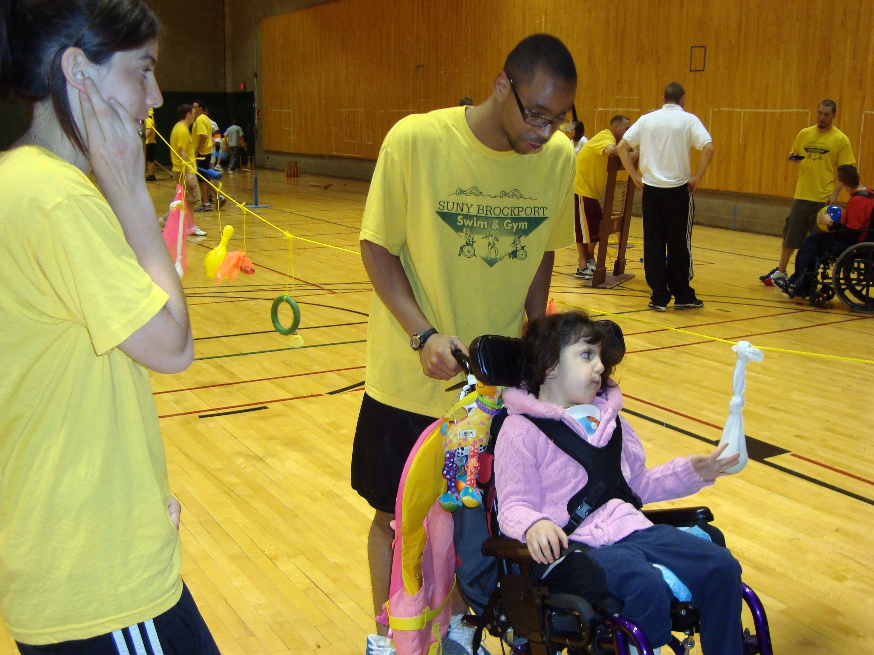
In their chairs continued
Student can bat balloons
Students can pull on thera-bands or surgical tubing (Modell
& Cox, 1999)
Student can bat using a racquet ace bandaged around their had, or play hockey with a hockey stick that is held on with velco or ace bandaged around their hand.

Slide 18
Over a bolster
Lying on their front over a bolster students can push balls back and forth, drop scarves or bean bags into buckets
Do push ups with assistance.
They can also reach up into higher buckets or baskets and drop items into higher targets.

Slide 19
Lying on a wedge mat or sitting on a mat with support from behind
Lying on their front over a wedge mat or sitting on a mat with support from behind students can push balls back and forth, drop scarves or bean bags into buckets, or do push ups with assistance. They can also reach up into higher buckets or baskets and drop items into higher targets.

Slide 20
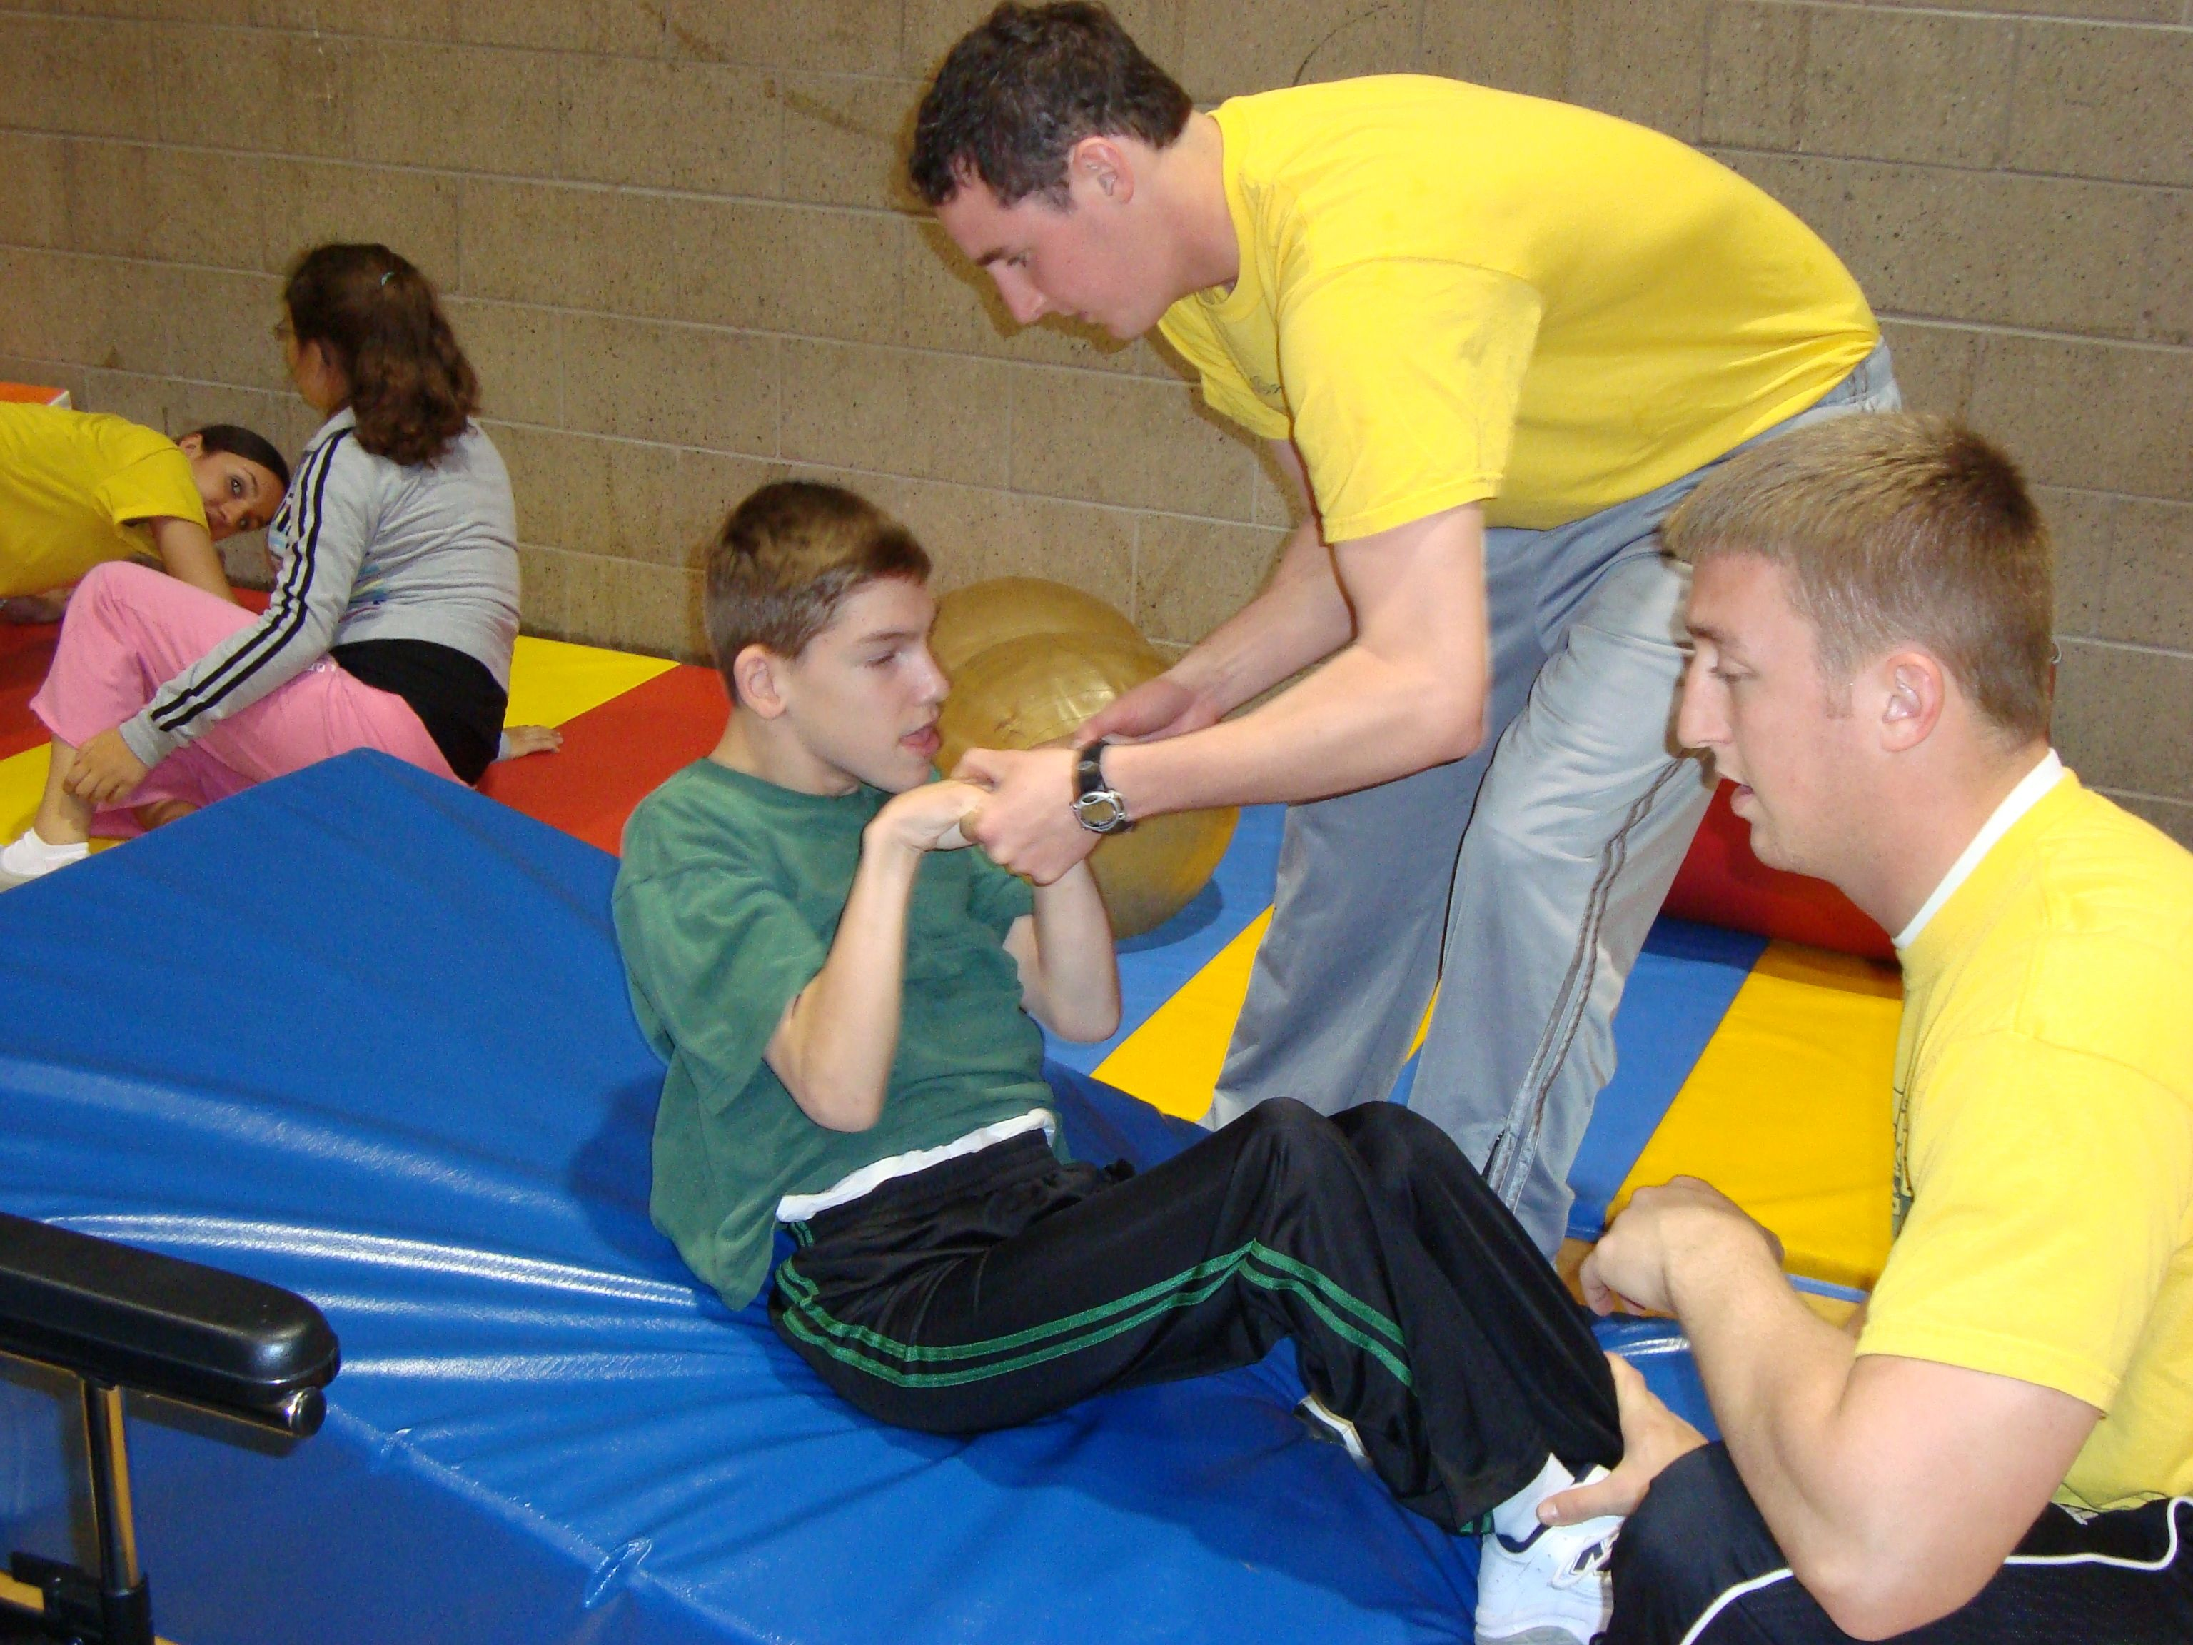
Wedge mat

Slide 21
Lying with their back on the mat
While a student is lying on their back students can kick a ball off of their feet.
They can also pull a scarf off of their face
Push a ball off of their chest
Reach up for scarves, or objects
Practice grasping and releasing into hula hoops.

Slide 22
Lying prone on a scooter or sitting with support
Hold on to a hula hoop while being pulled around
They could push themselves with their feet as much as possible
They can hold on to a rope or hula hoop with support and be pulled around
they can push themselves with their arms.

Slide 23
In the pool
While prone or supine in the pool with or without flotation devices students can work on kicking, paddling with their arms, and relaxation of their body.
They can work on range of motion, grasping and releasing objects, and object control skills
They can also work on standing on the side of the pool while holding on to the side of the pool as independently as possible.

Slide 24
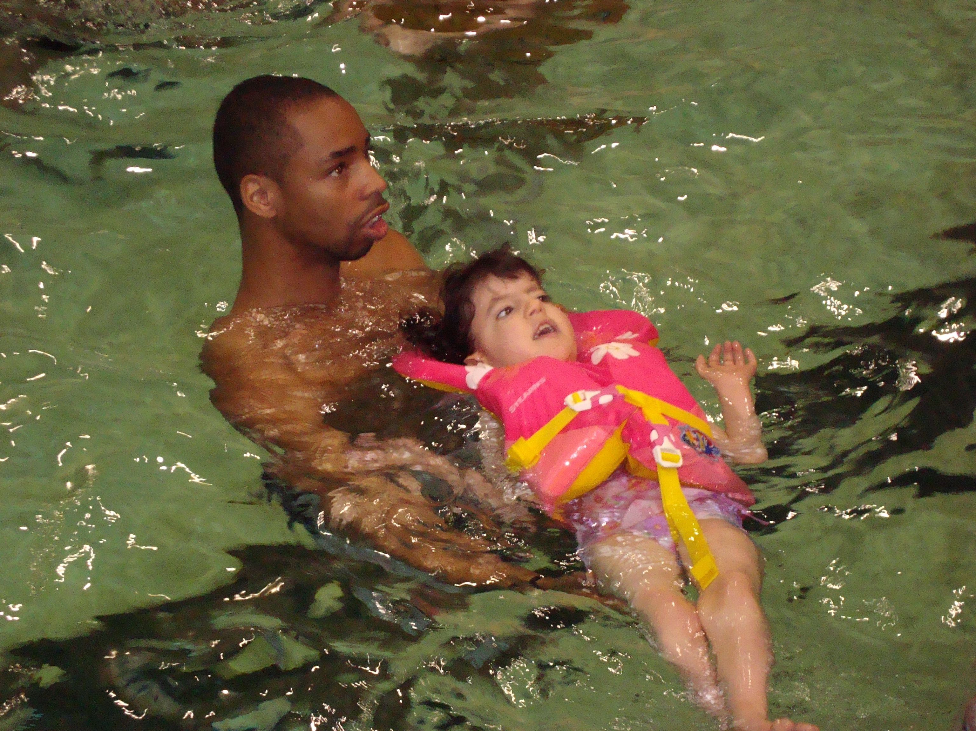
Pool positioning

Slide 25
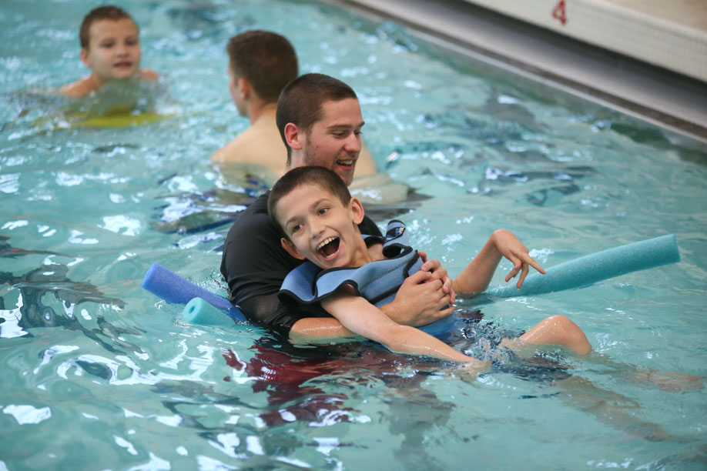
Aquatics Considerations
Pool transfers
Pool temperature-84 degrees minimum
1:1 instruction
Positioning
Assessment (3 P’s)
Medical issues
Goal setting
  locomotor skills
  independence
  Fitness
  swim skills
  etc

Slide 26
Support Staff: Paraeducators and Peer tutors
1:1-Mandatory with Children with severe disabilities
Must be trained and must be rewarded
Paraeducator training
  “Paraeducators in Physical Education” Human Kinetics Publishers
Peer Tutor Training
  Strategies for Inclusion: Physical Education for Everyone Human Kinetics Publishers

Slide 27
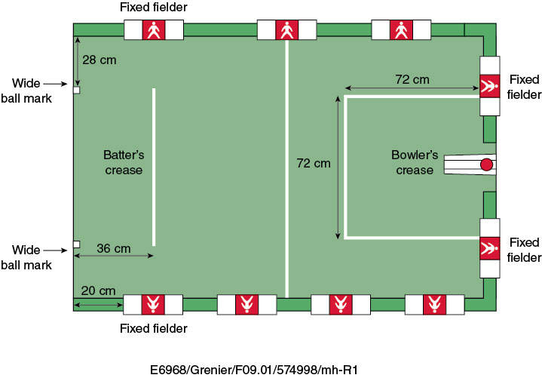
Sport opportunities
Power soccer
Power hockey
Table top cricket
Boccia
Swimming
Sitting volleyball
Archery
Other?

Slide 28
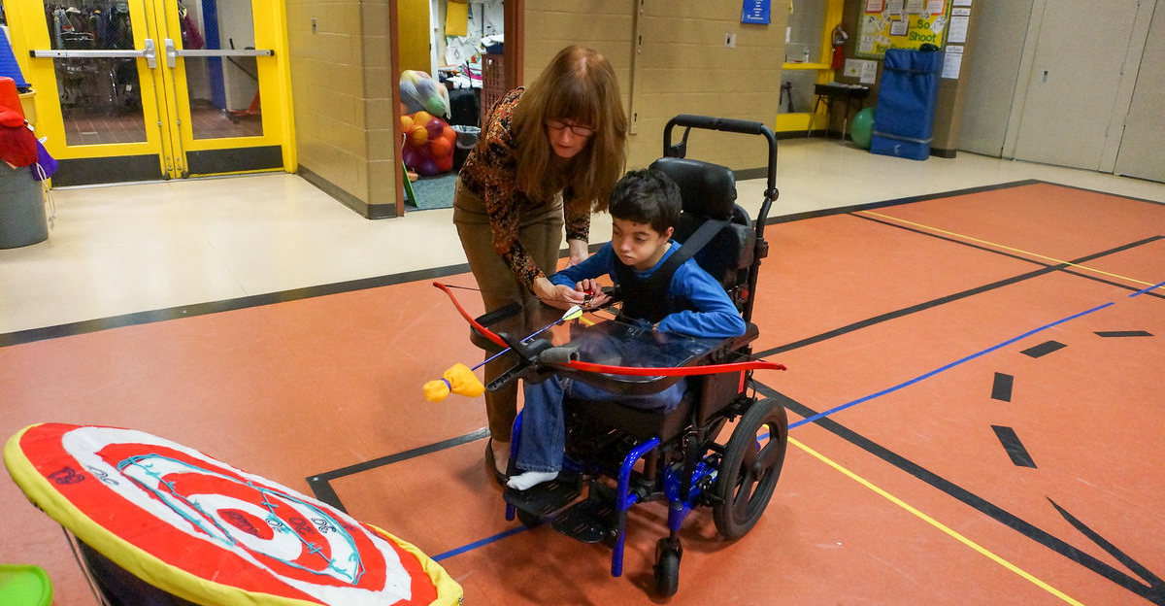
Archery

Slide 29

Questions? Ideas?

